Slide 1
CITY CONNECT CAR LOAN PROCESSING SYSTEMS

Slide 2

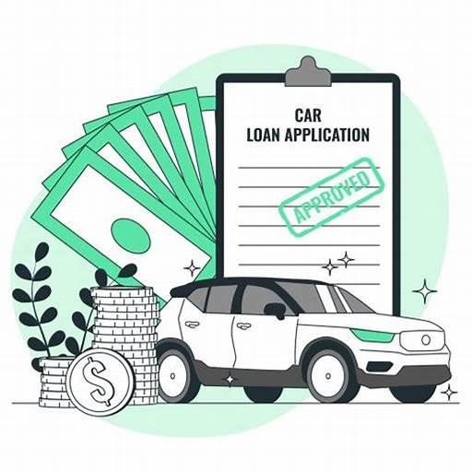
CONTENTS
INTRODUCTION
REQUIREMENT ANALYSIS
FLOW DIAGRAMS
PHASES

Slide 3
INTRODUCTION

Slide 4
The tasks involve loading applicant and car loan details into the bank's database, updating repayment details from collection agencies and CITY CONNECT Bank, and generating daily and weekly reports on car loan repayments. Additionally, there is a task for cleaning up and loading applicant, car loan, and payment data into the history database.

Slide 5
REQUIREMENT ANALYSIS

Slide 6
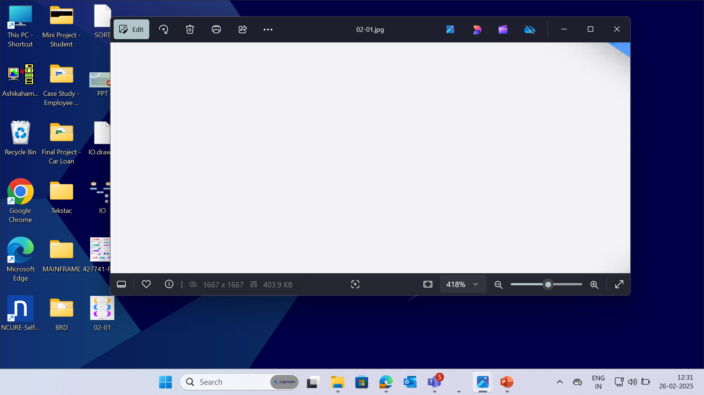


PCOMM Emulator - to access the Mainframe environment.
Pcom Emulator
SOFTWARE
REQUIREMENTS
DB2 - used for storing
the data in format.
TSO, JCL – to run and execute programs.
COBOL – to access inputs and perform required computations.
6
© 2025–2027 Cognizant | Private

Slide 7
CONTEXT FLOW DIAGRAM

Slide 8
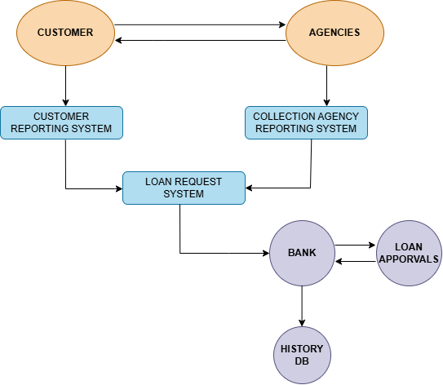
The context flow diagram shows loading applicant and car loan details, updating repayment information, generating repayment reports and cleaning/loading data into the history database.

Slide 9
BUSINESS REQUIREMENT OVERIEW

Slide 10
BRD 01 - AISHWARYA NAGA SREEJA SURYA UPPALA (L)
(2372558)
BRD 02 - ADVAIT RANE
(2372575)
BRD 03 - REESHMA K R
(2372574)
BRD 04 - ASHIK AHAMED H
(2372596)
BRD 05 - HUSSAIN LOKHANDWALA (TL)
(2372539)

Slide 11
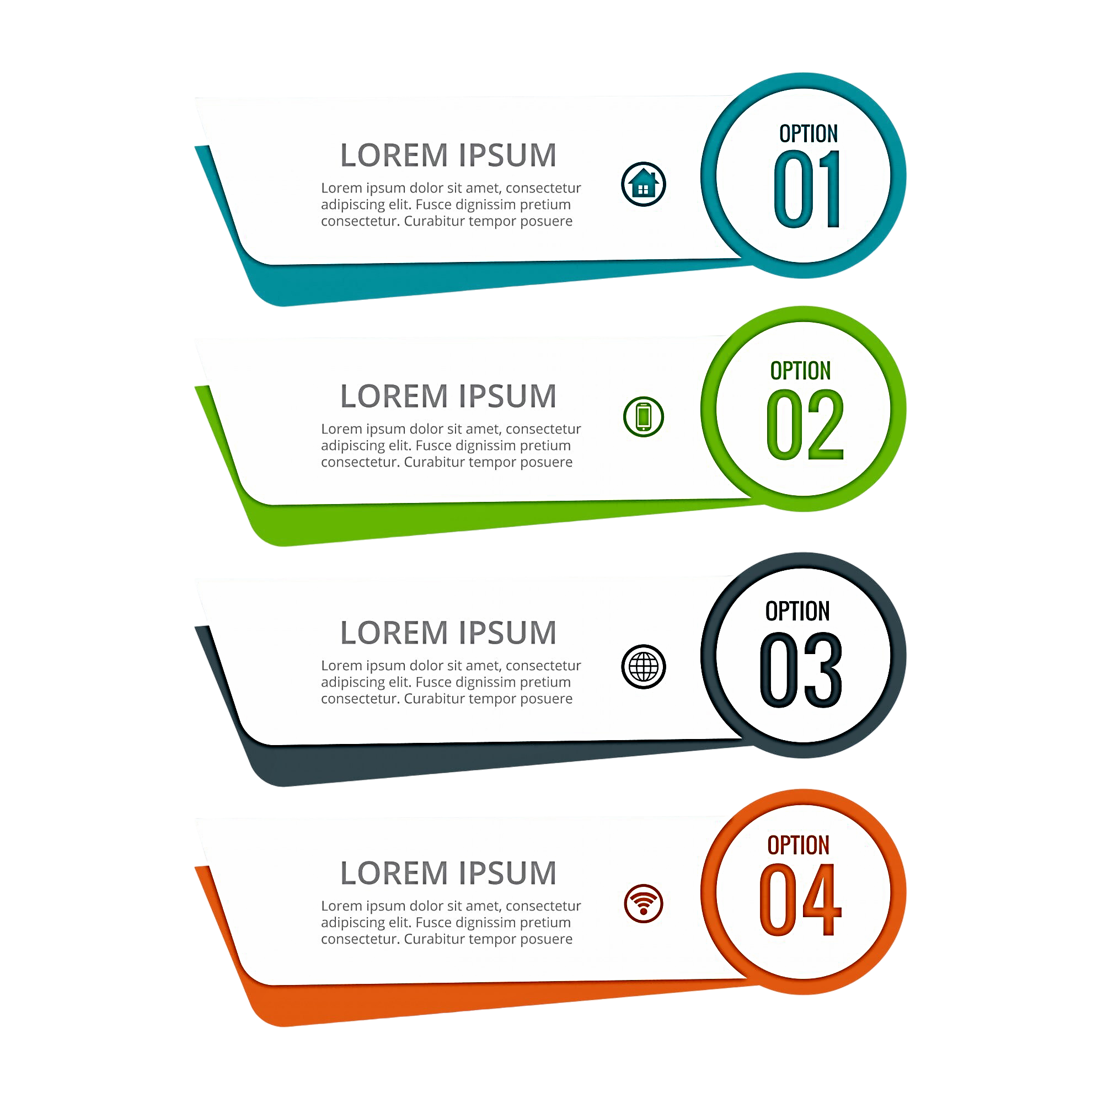




Load applicant and car loan details into the bank’s database to ensure accurate loan processing and data integrity.
BRD
01
Update the bank's database monthly with car loan repayment details from collection agencies and CITY CONNECT Bank, ensuring data accuracy.
BRD
02
Generate a daily report listing car loans with missed repayments to monitor overdue accounts and take necessary actions.
BRD
03
© 2025–2027 Cognizant | Private
11

Slide 12


Create a weekly report of car loans with repayments received in the current week to track payment activity and maintain financial records.
BRD
04
Clean up and load applicant, car loan, and payment data into the history database for accurate record-keeping and future reference.
BRD
05
© 2025–2027 Cognizant | Private
12

Slide 13
DATA FLOW DIAGRAM

Slide 14
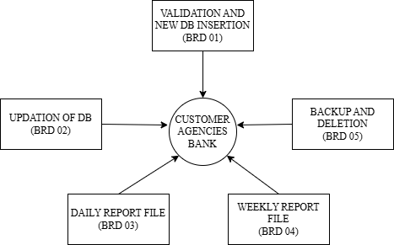
The Data Flow Diagram (DFD) visually represents the flow of data within a system, illustrating how data is processed.

Slide 15
BRD OVERVIEW

Slide 16
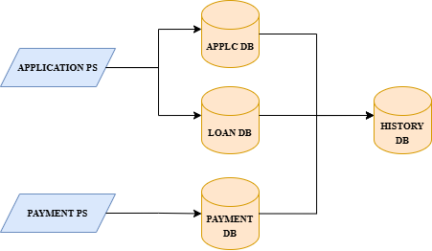
The below Flow Diagram depicts the overall process done in Car Loan Processing systems.

Slide 17
BRD : 01 - Load Applicant and Car Loan Details
The objective is to efficiently process applicant and car loan details. This involves collecting and backing up the data, splitting loan details into short-term and long-term categories, and loading the information into their respective databases. The Master Loan VSAM KSDS file is updated with active loan details. Finally, a report is generated for applicants with loans over two years in the standard format.

Slide 18
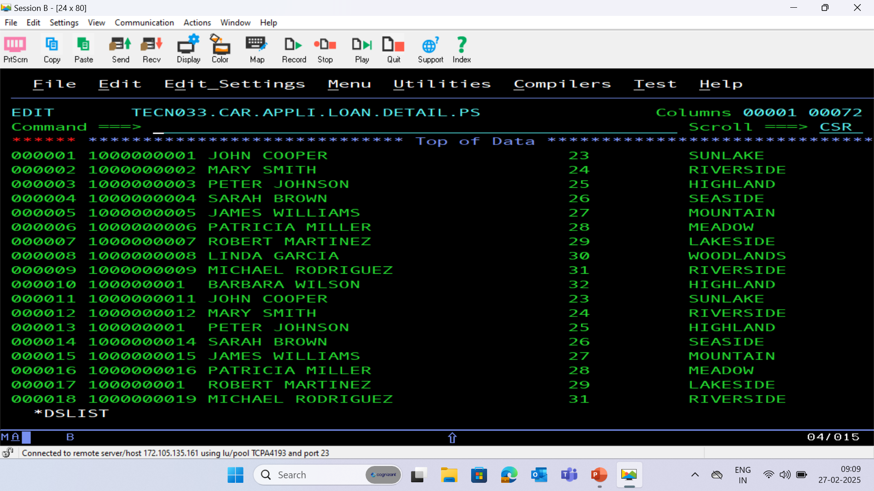
APPLICATION PS FILE

Slide 19
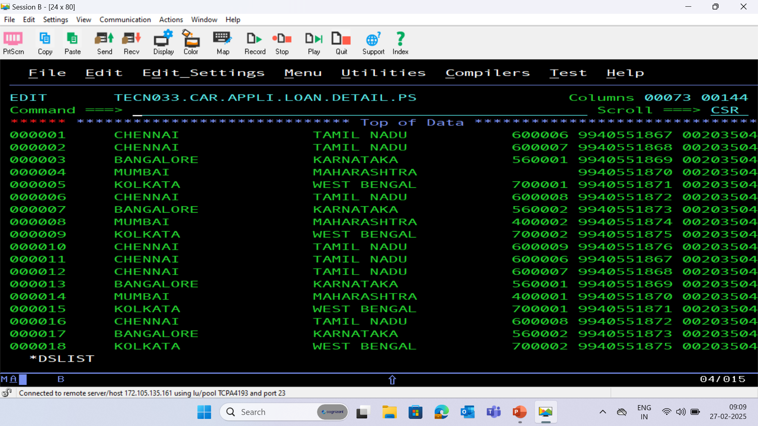

Slide 20
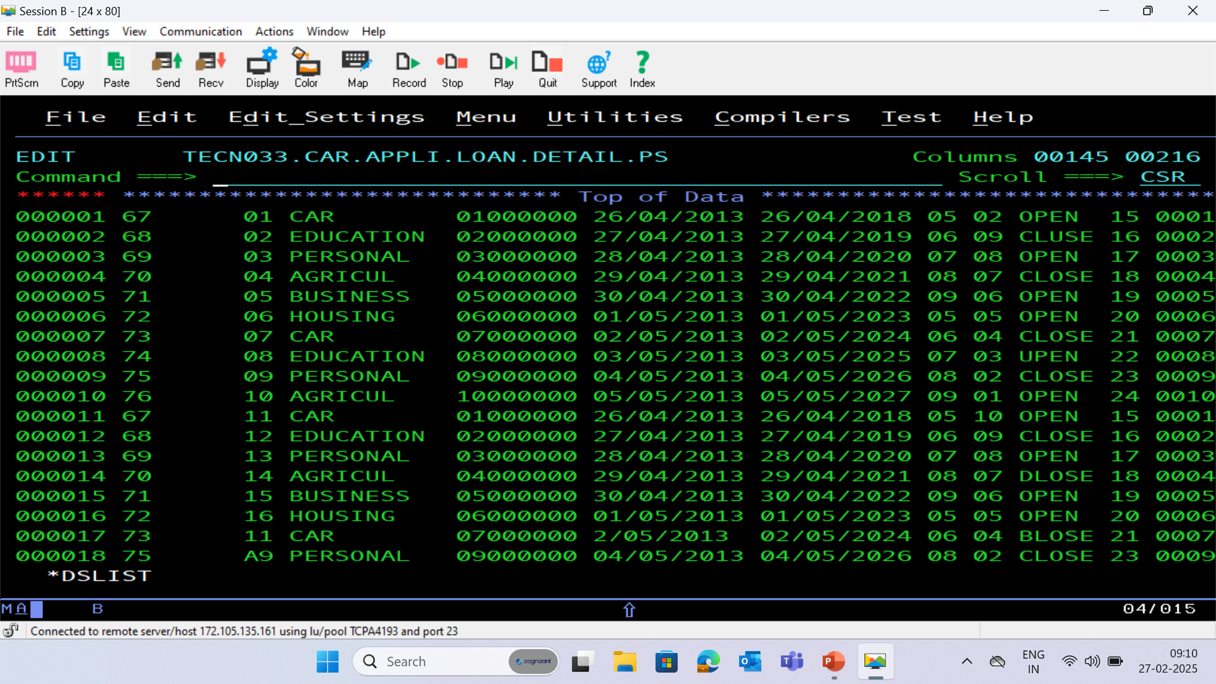

Slide 21
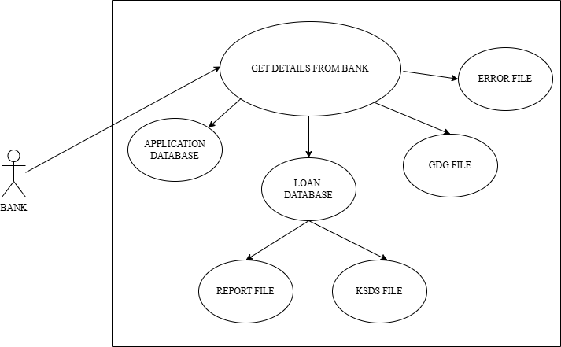
BRD : 01 – Use Case Diagram

Slide 22
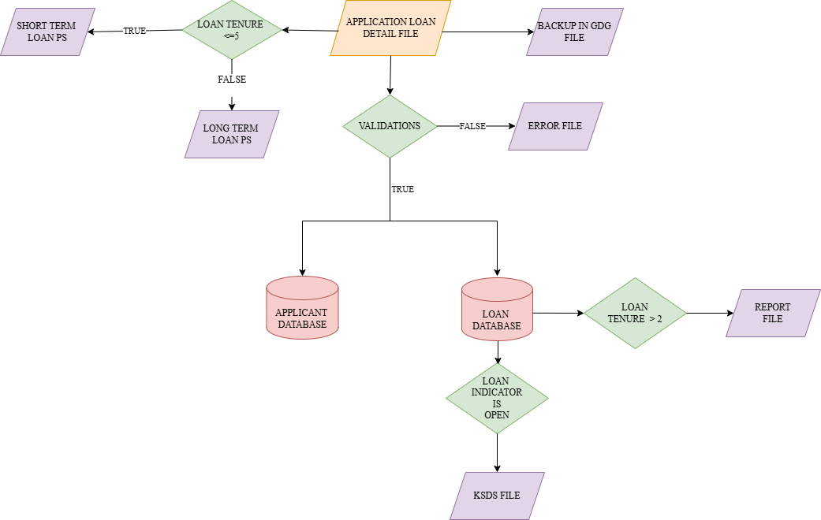
BRD : 01 – Flow Chart

Slide 23
PROCESS FLOW
Backing Up Data
The process begins by obtaining applicant and car loan details from the bank and storing this information in a GDG file with a limit of 16 versions, ensuring data is backed up securely.
2. Categorizing Loan Details
Next, the car loan details are split into two files based on loan tenure. Loans of 5 years or less are short-term, while those over 5 years are long-term, aiding in specialized processing by different divisions.
3. Loading Applicant Details
Applicant information, including ID, name, address, contact number, and savings account number, is loaded into the Application Database to maintain accurate records for further processing.

Slide 24
4. Loading and Updating Loan Details
Loan-specific details such as Loan ID, amount, approval date, closure date, balance, and next due date are loaded into the Loan Database. These details are also added to the Master Loan VSAM KSDS file, which contains records of all active loans.
5. Generating Reports
Details of applicants with loan tenures greater than two years are extracted from the Loan Database. Separate report files are generated for these applicants in a standard format, ensuring organized data presentation and readability.

Slide 25
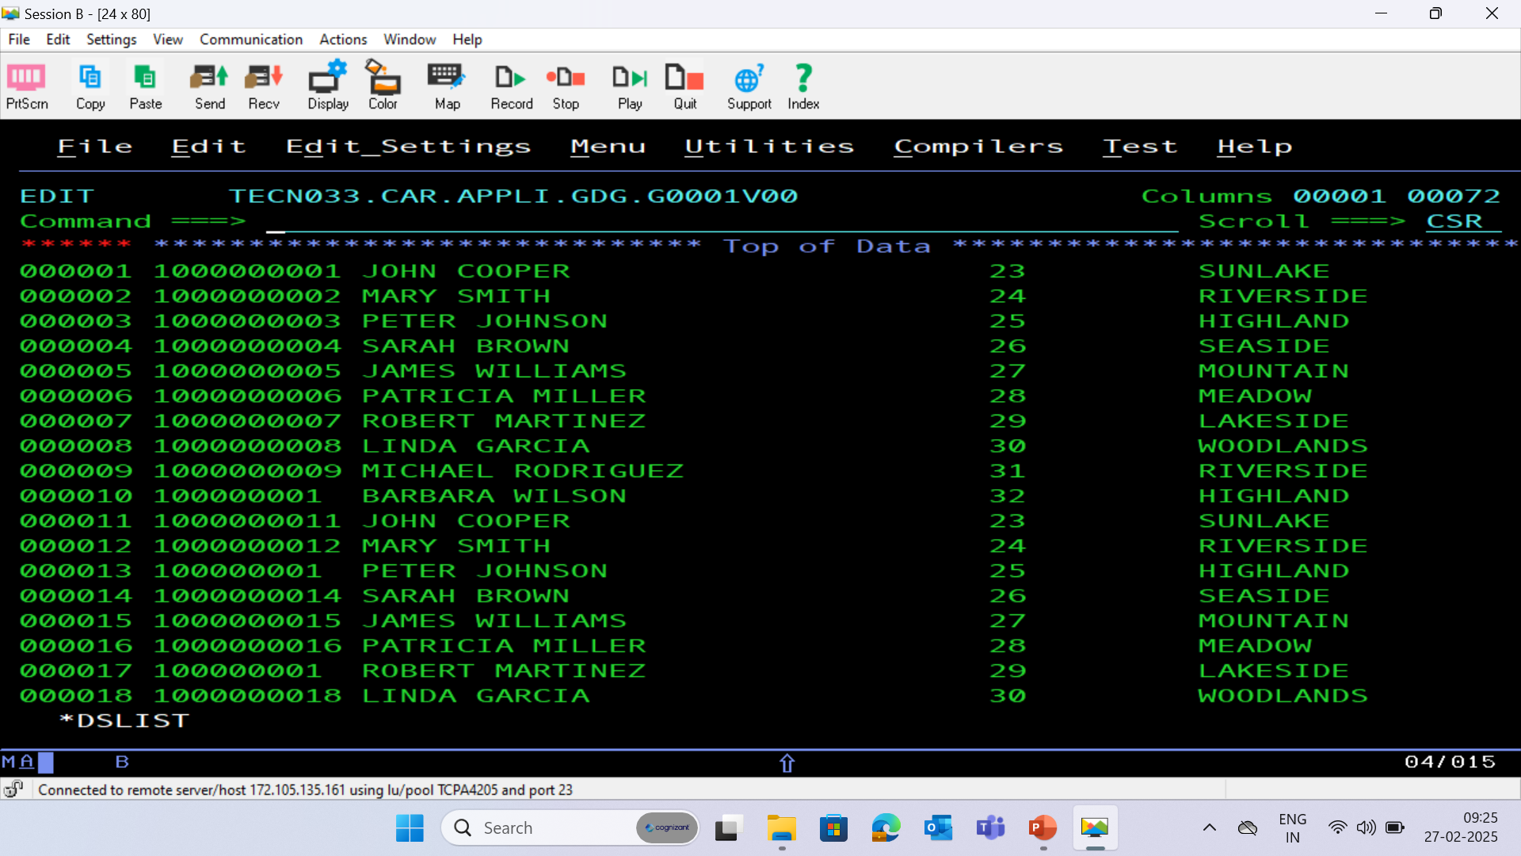
GDG BACKUP FILE

Slide 26
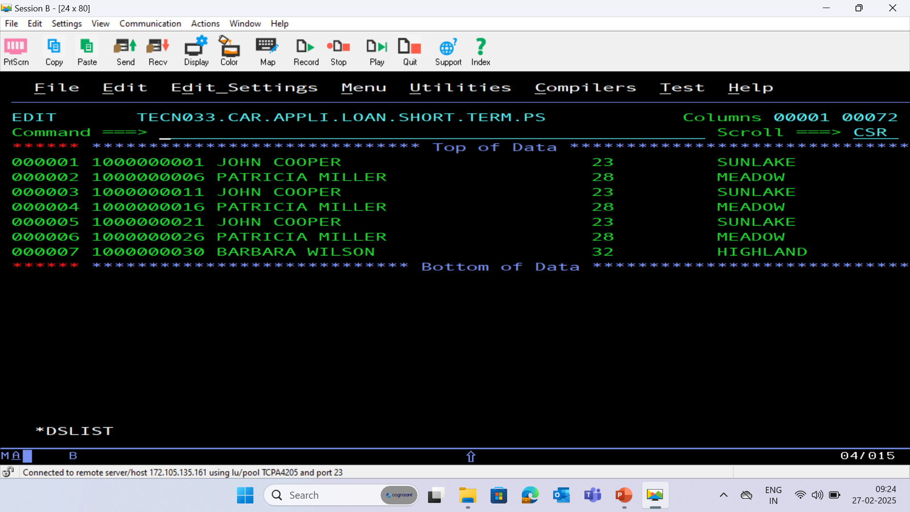
SHORT TERM PS FILE

Slide 27
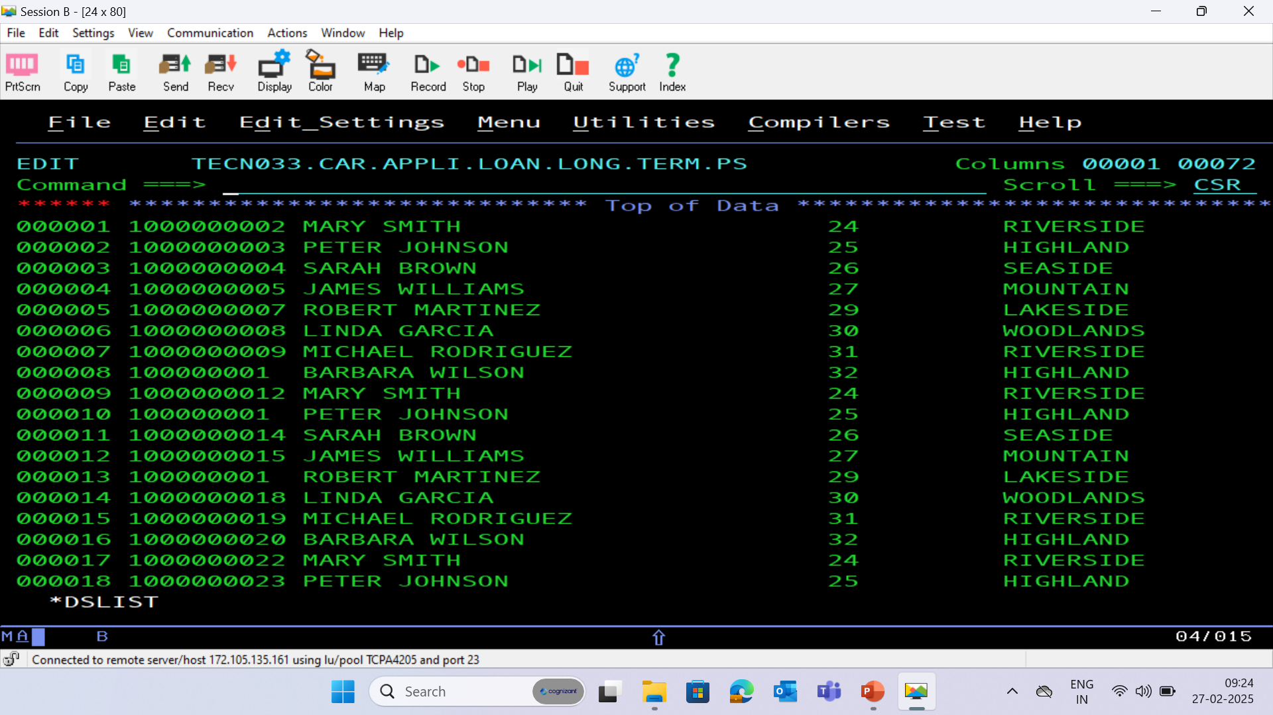
LONG TERM PS FILE

Slide 28
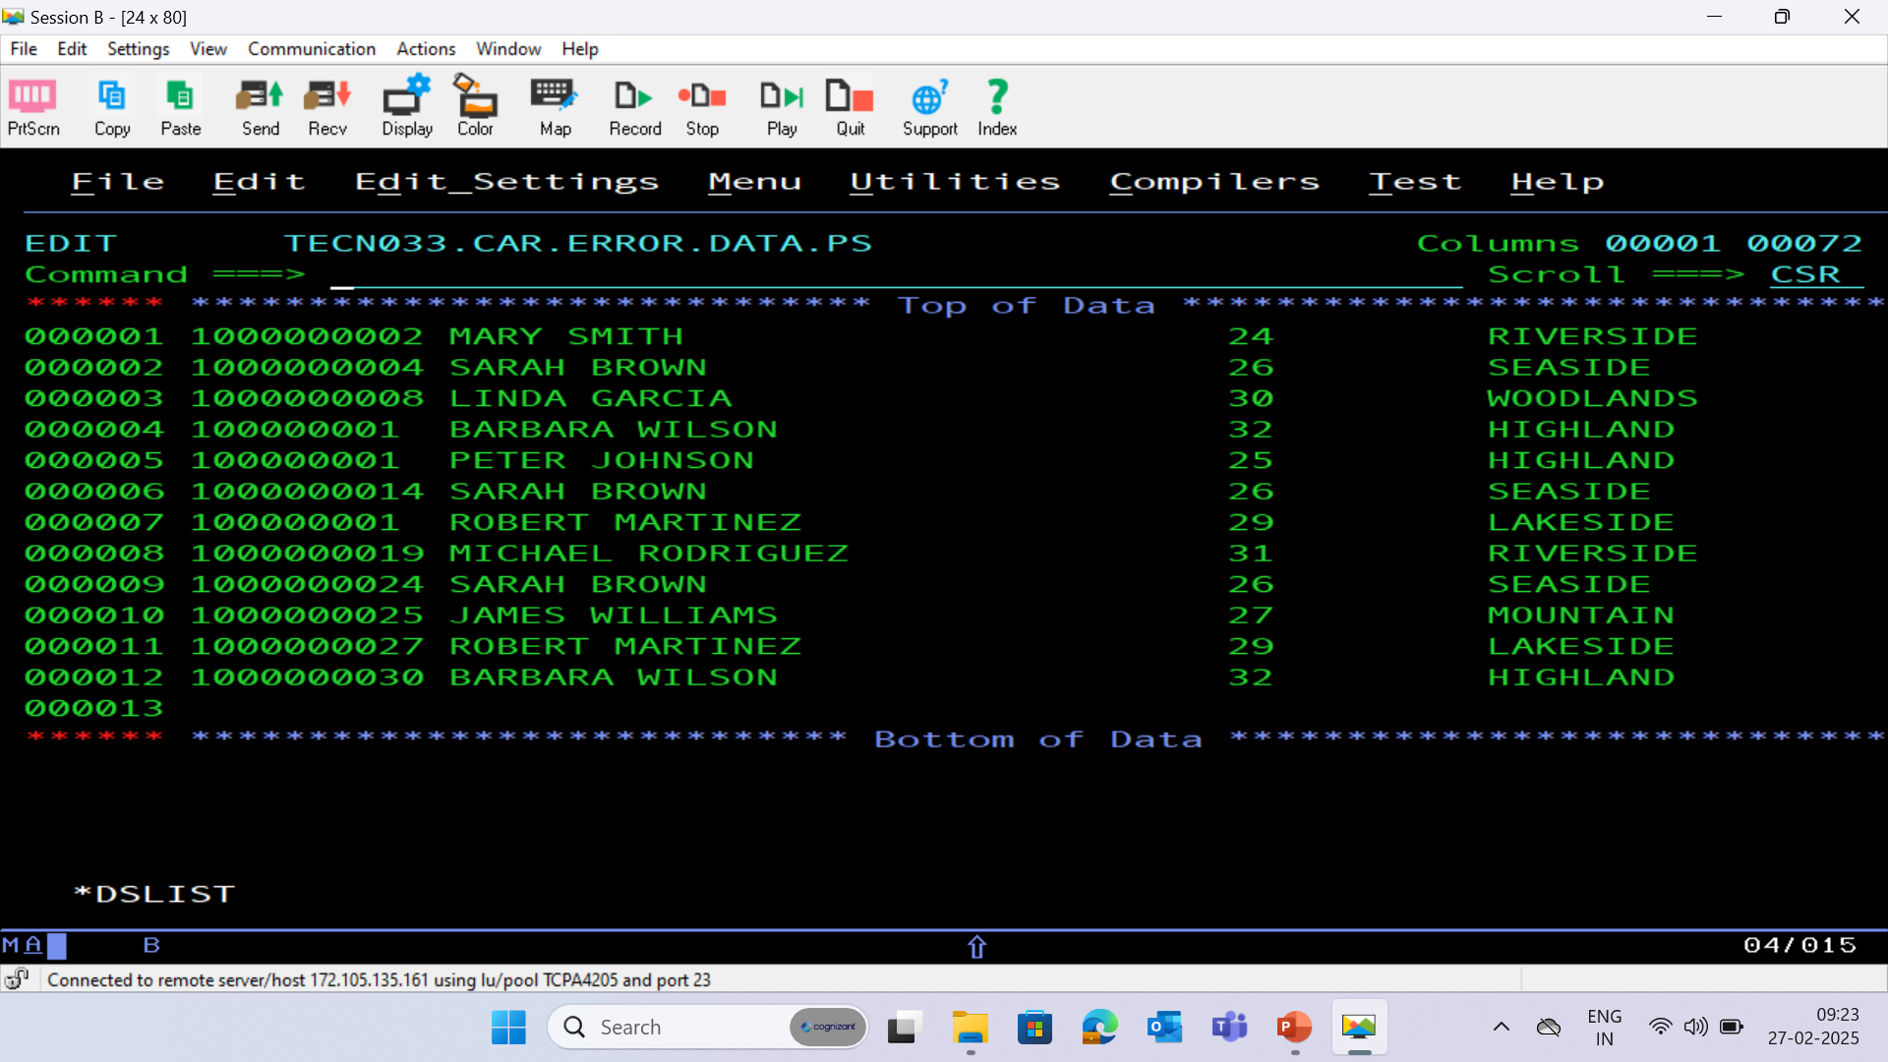
ERROR PS FILE

Slide 29
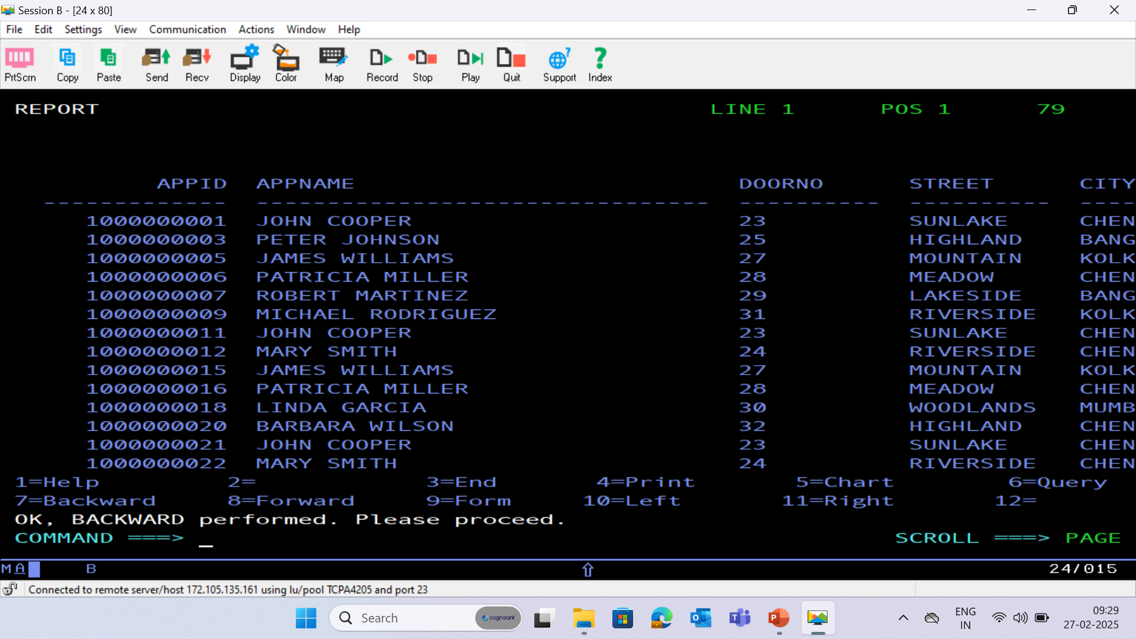
APPLICATION DATABASE - (APPLC)

Slide 30
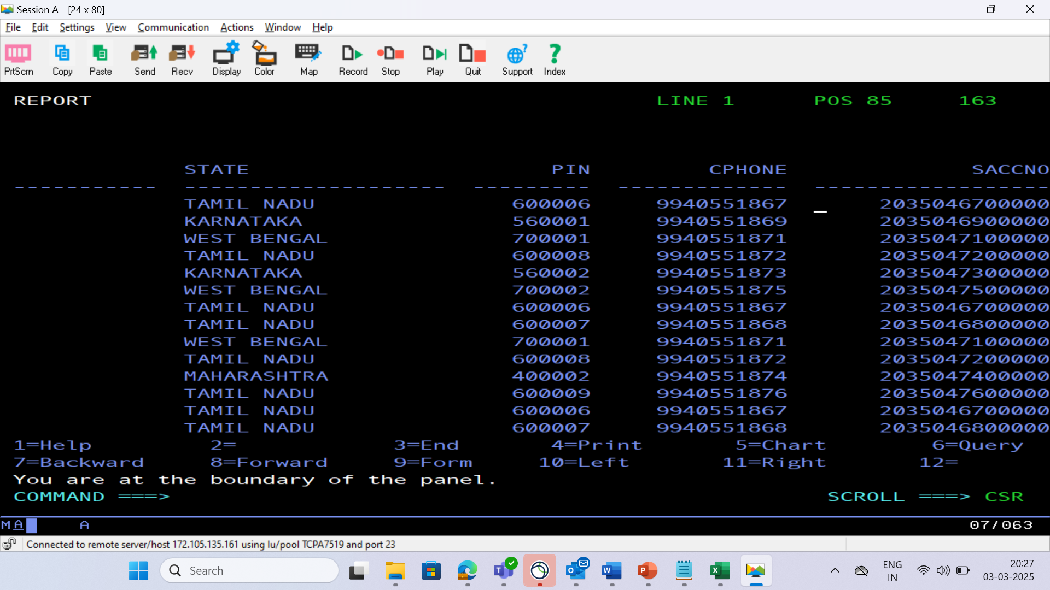

Slide 31
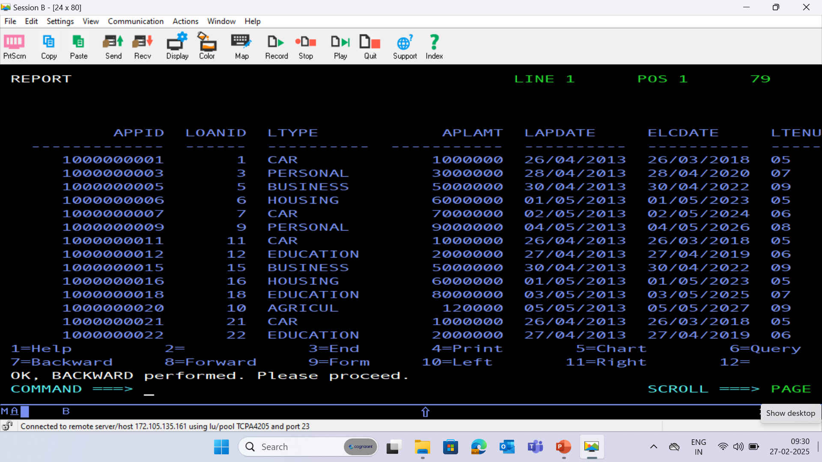
LOAN DATABASE - (LOAN)

Slide 32
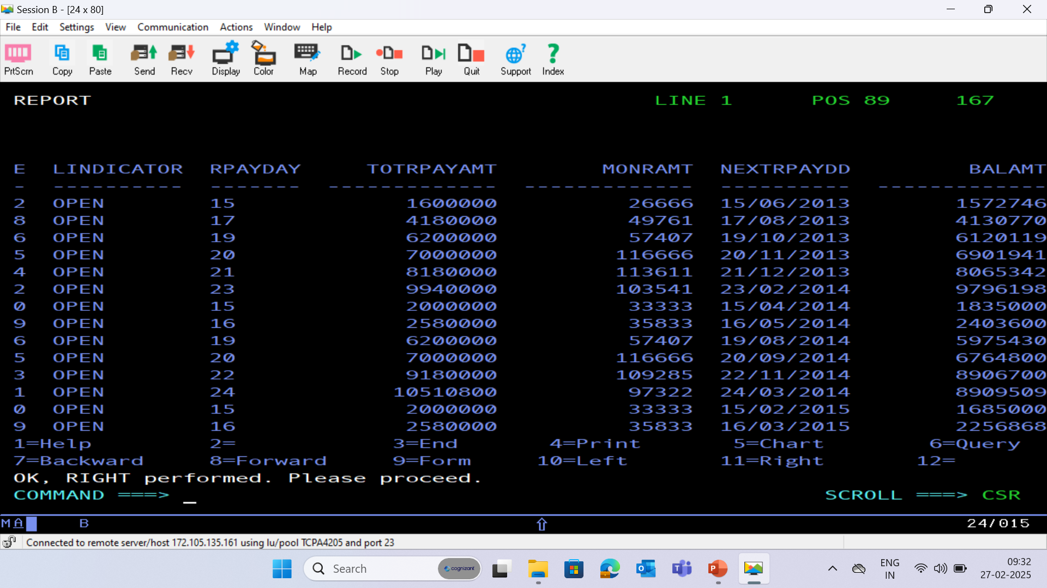

Slide 33
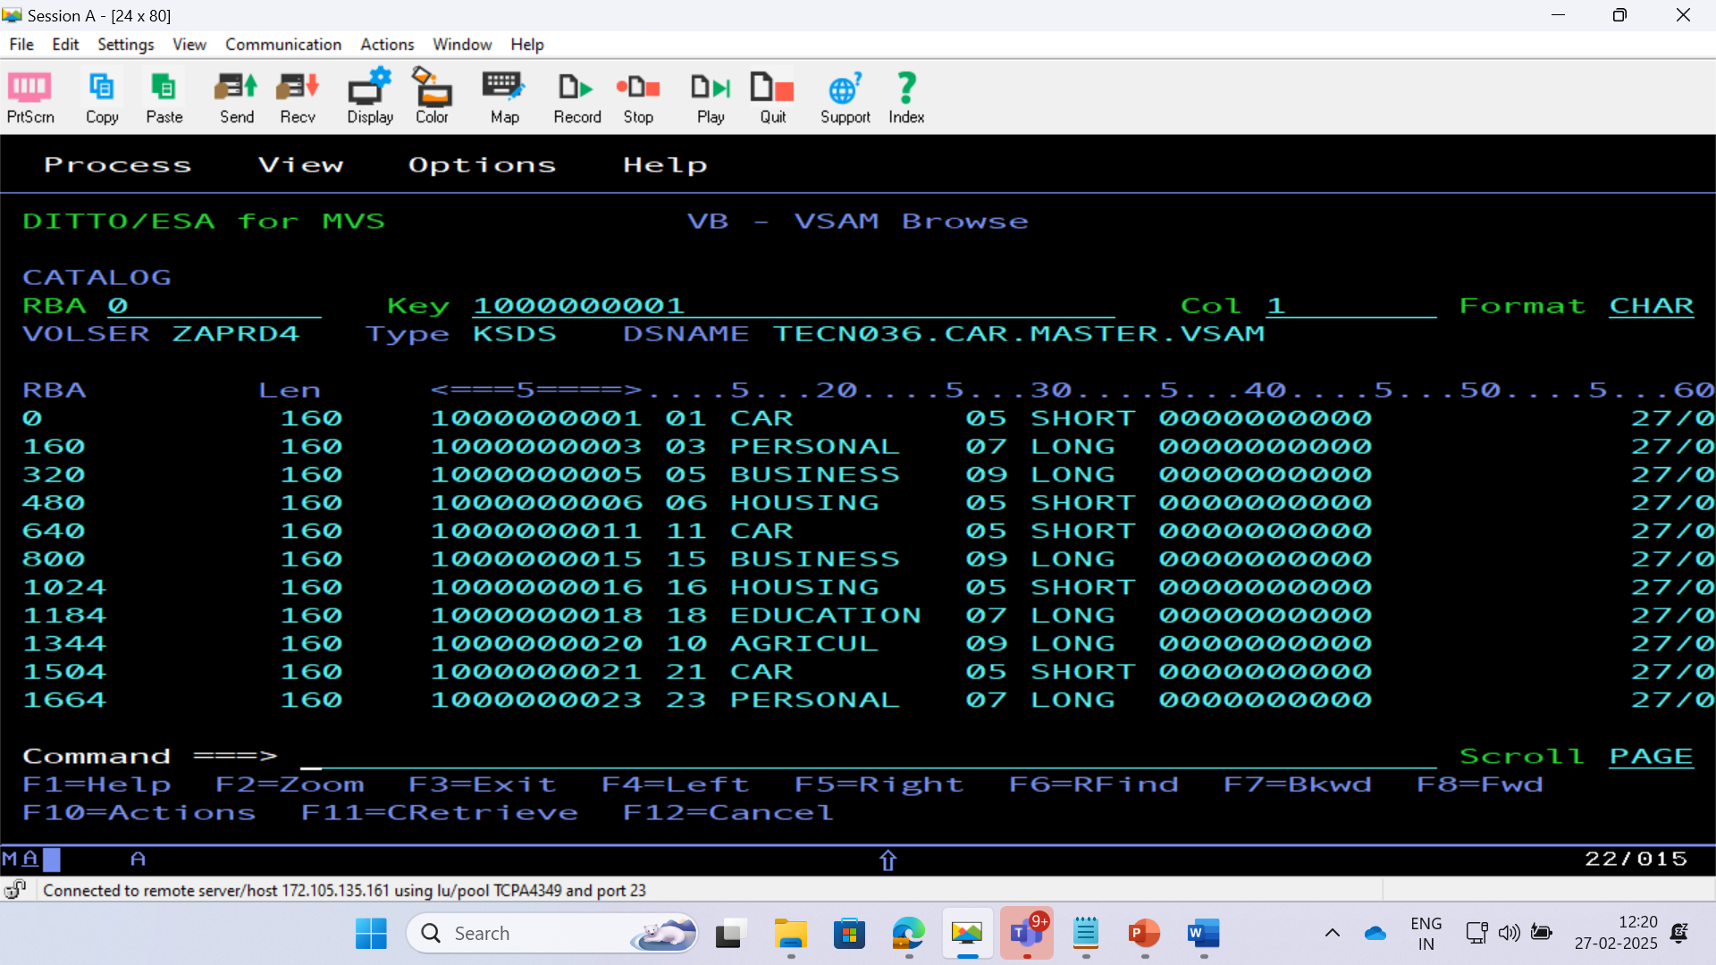
BRD 01 VSAM CLUSTER

Slide 34
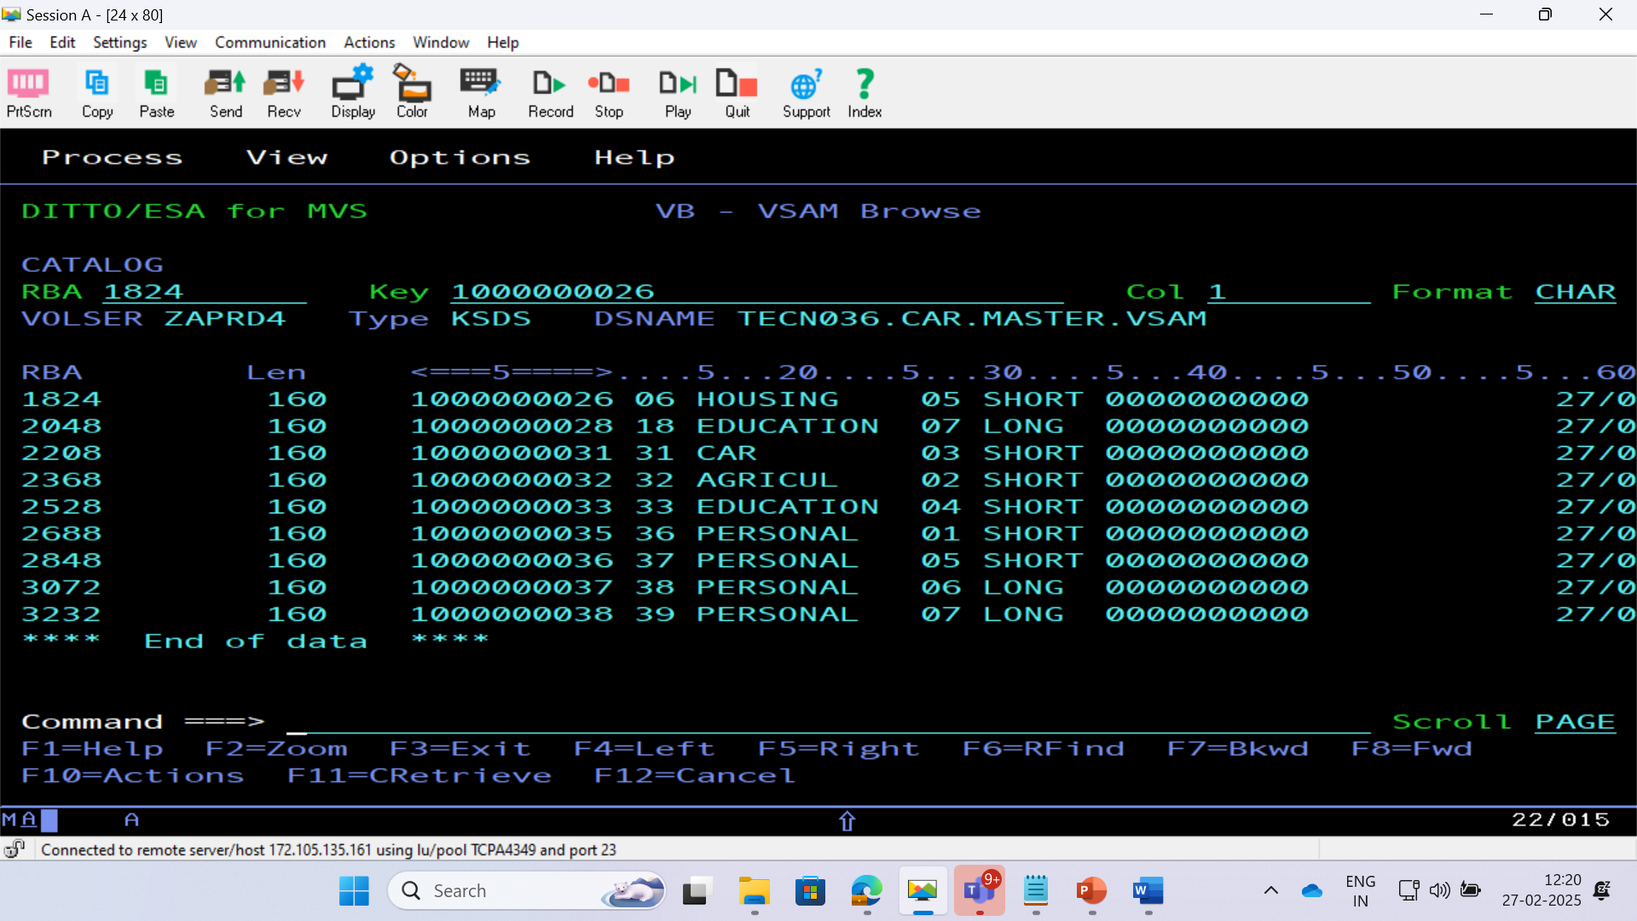

Slide 35
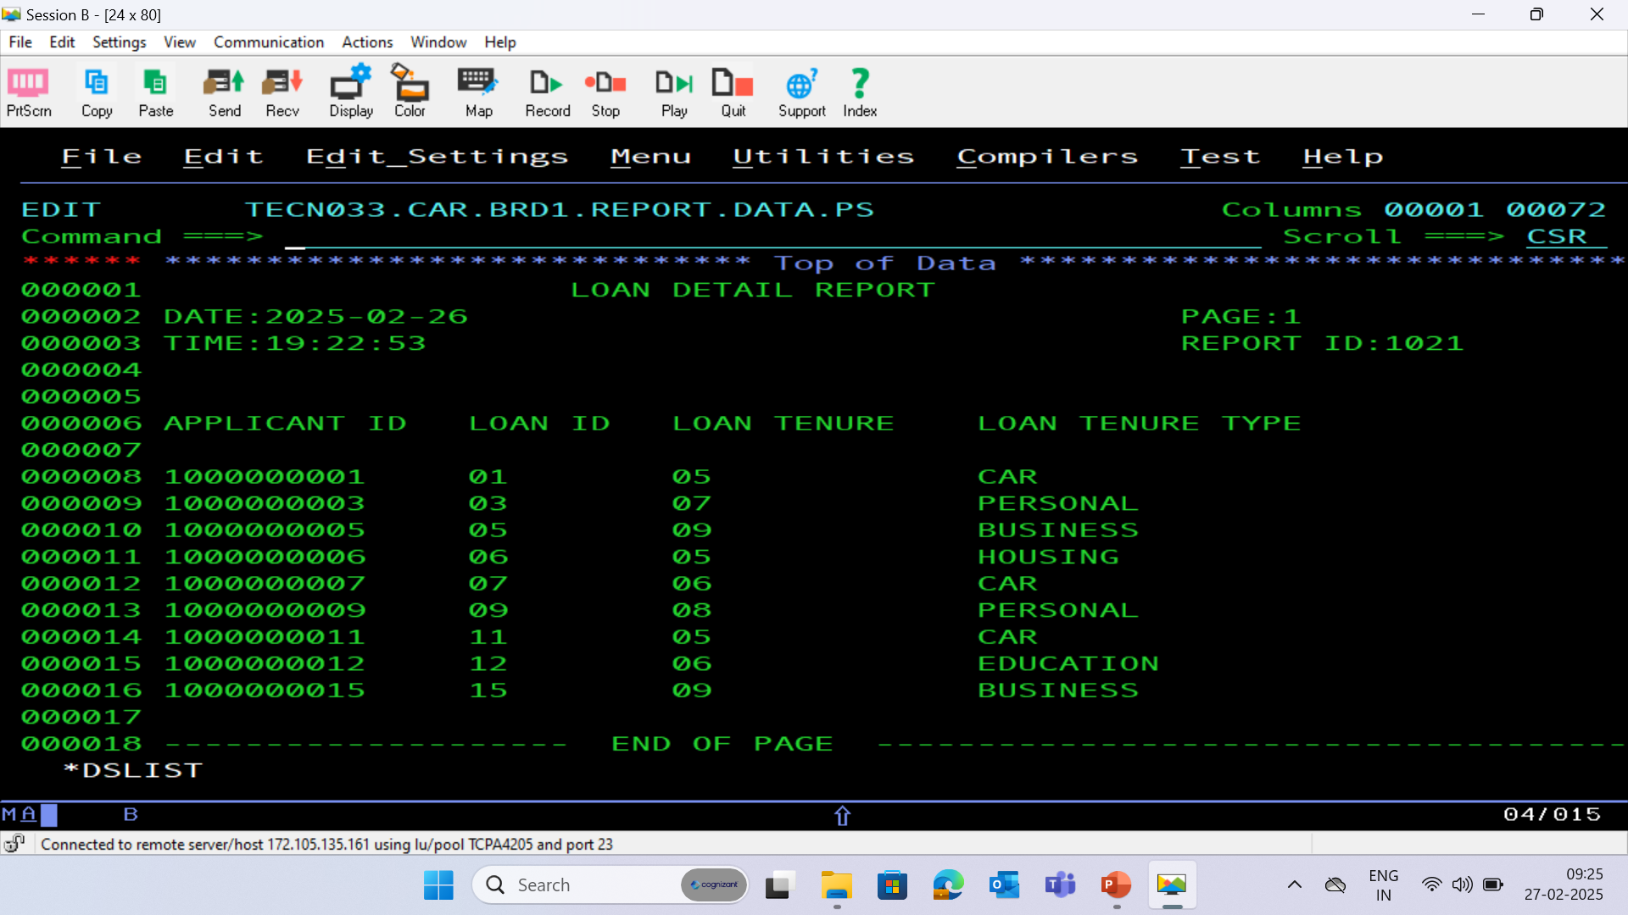
BRD 01 REPORT PS FILE

Slide 36
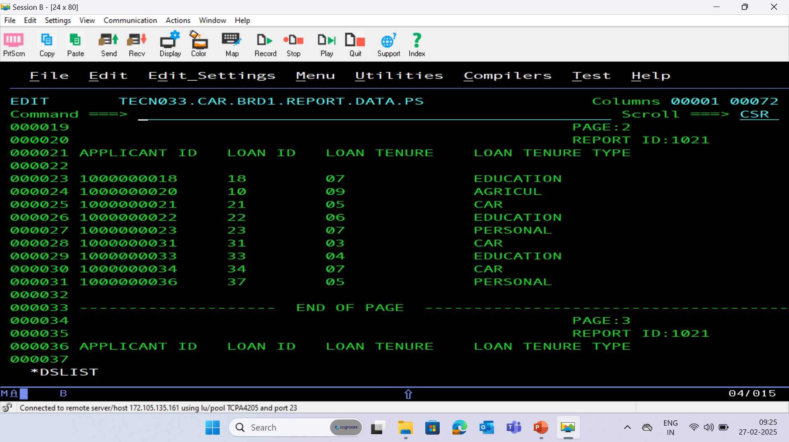

Slide 37
BRD : 02 - Monthly Car Loan Repayment Update
The process involves obtaining car loan payment details from banks and collection agencies, calculating the total amounts paid via cheque and cash modes, and updating the payment database with recalculated balances after applying a 2% tax. Payment details are loaded into the database, loan details are updated, and the Master Loan VSAM KSDS file is revised. Finally, accumulated amounts for each Loan ID are calculated and inserted into the Master Loan VSAM file.

Slide 38
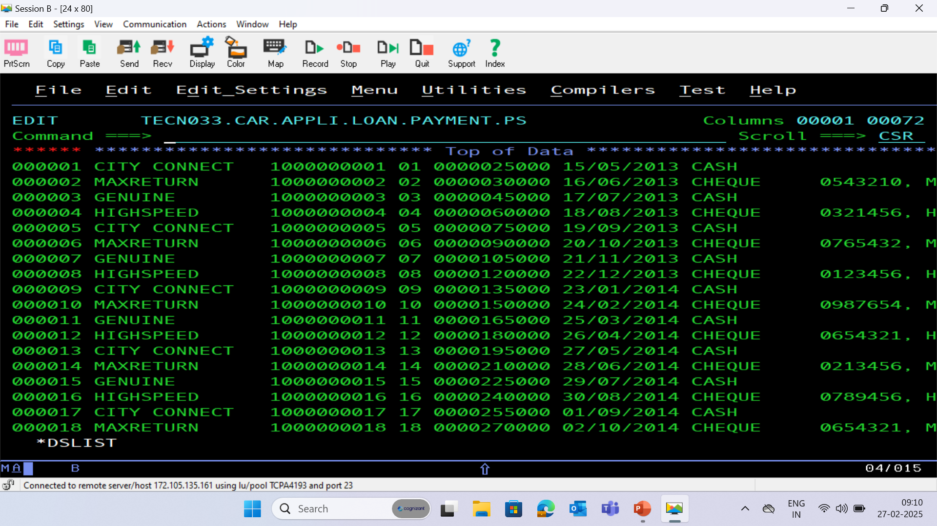
PAYMENT PS FILE

Slide 39
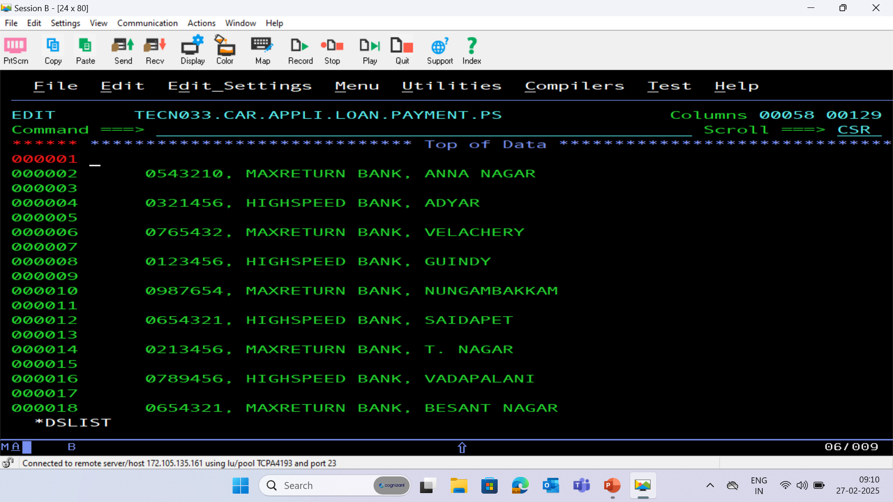

Slide 40
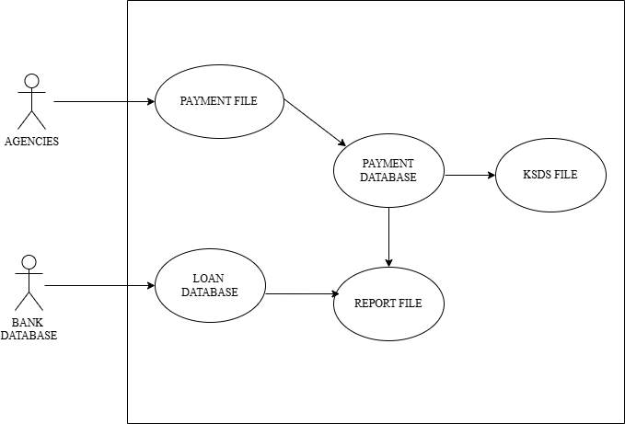
BRD : 02 – Use Case Diagram

Slide 41
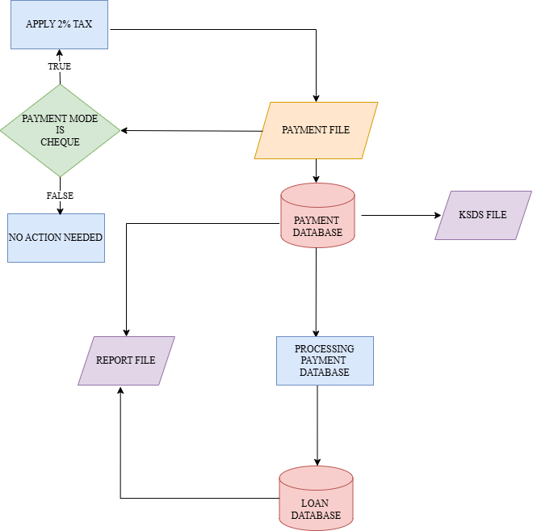
BRD : 02 – Flow Chart

Slide 42
PROCESS FLOW
Collecting Payment Details
Payment details for car loans are collected from banks and collection agencies and are used to create a comprehensive loan repayment detail file. This ensures all payment information is captured for further processing.
2. Calculating Payment Totals
The total amounts paid via cheque and cash modes are calculated, along with the number of payments made using each mode.
3. Updating Balance Amounts
For applicants who made payments via cheque, the balance amounts are recalculated, and a 2% tax is applied to the amount paid. The recalculated amounts are then updated in the payment database to reflect accurate financial records.

Slide 43
4. Loading Payment and Loan Details
Payment details, including the amount paid, payment date, previous and current balance amounts, payment mode, and cheque details, are loaded into the Payment Database. Similarly, loan details are updated, including the loan indicator, next repayment due date, and balance amount.
5. Generating Reports
Details of applicants with loan tenures greater than two years are extracted from the Loan Database. Separate report files are generated for these applicants in a standard format, ensuring organized data presentation and readability.

Slide 44
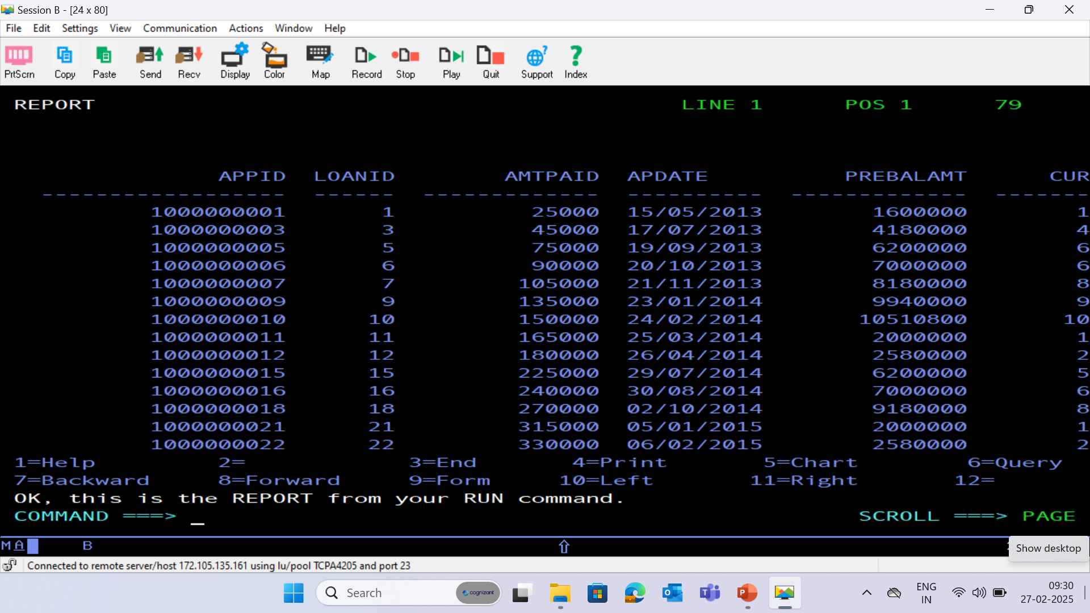
PAYMENT DATABASE - (PAYMENT)

Slide 45
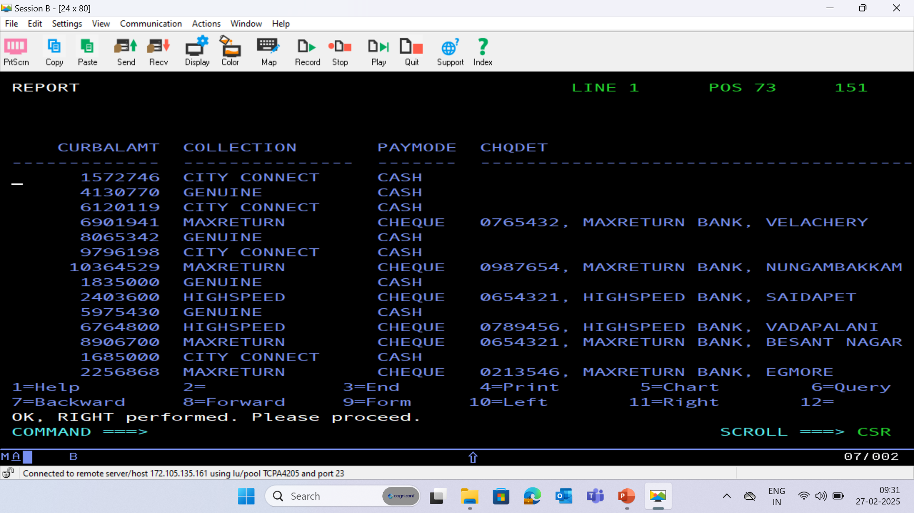

Slide 46
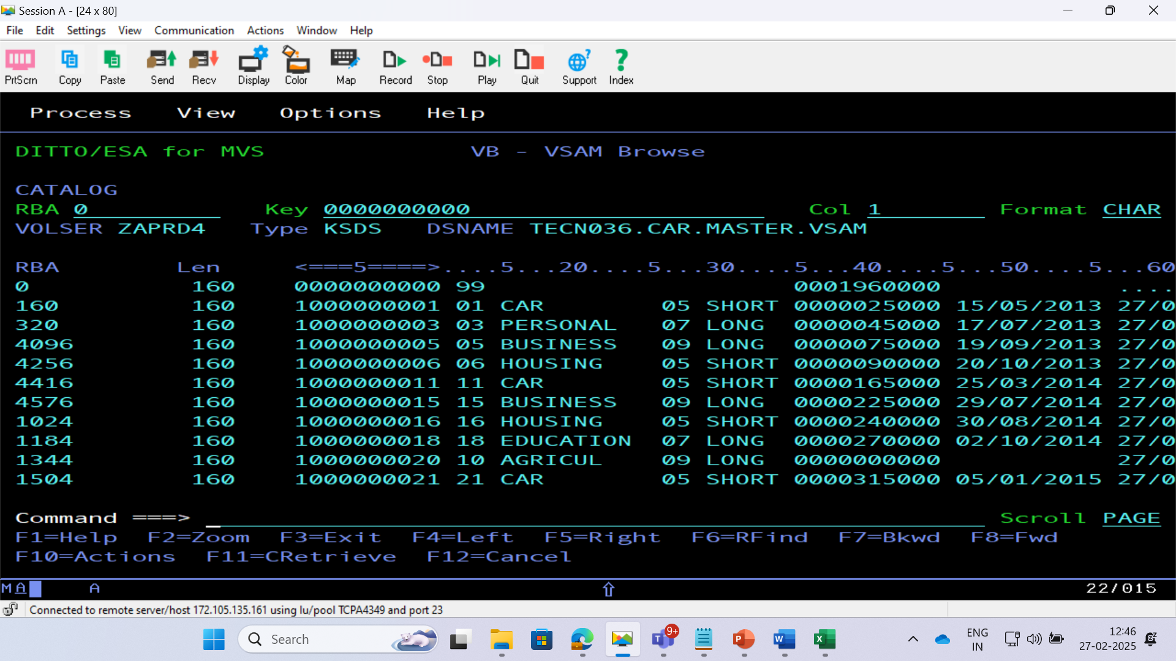
BRD 02 VSAM CLUSTER

Slide 47
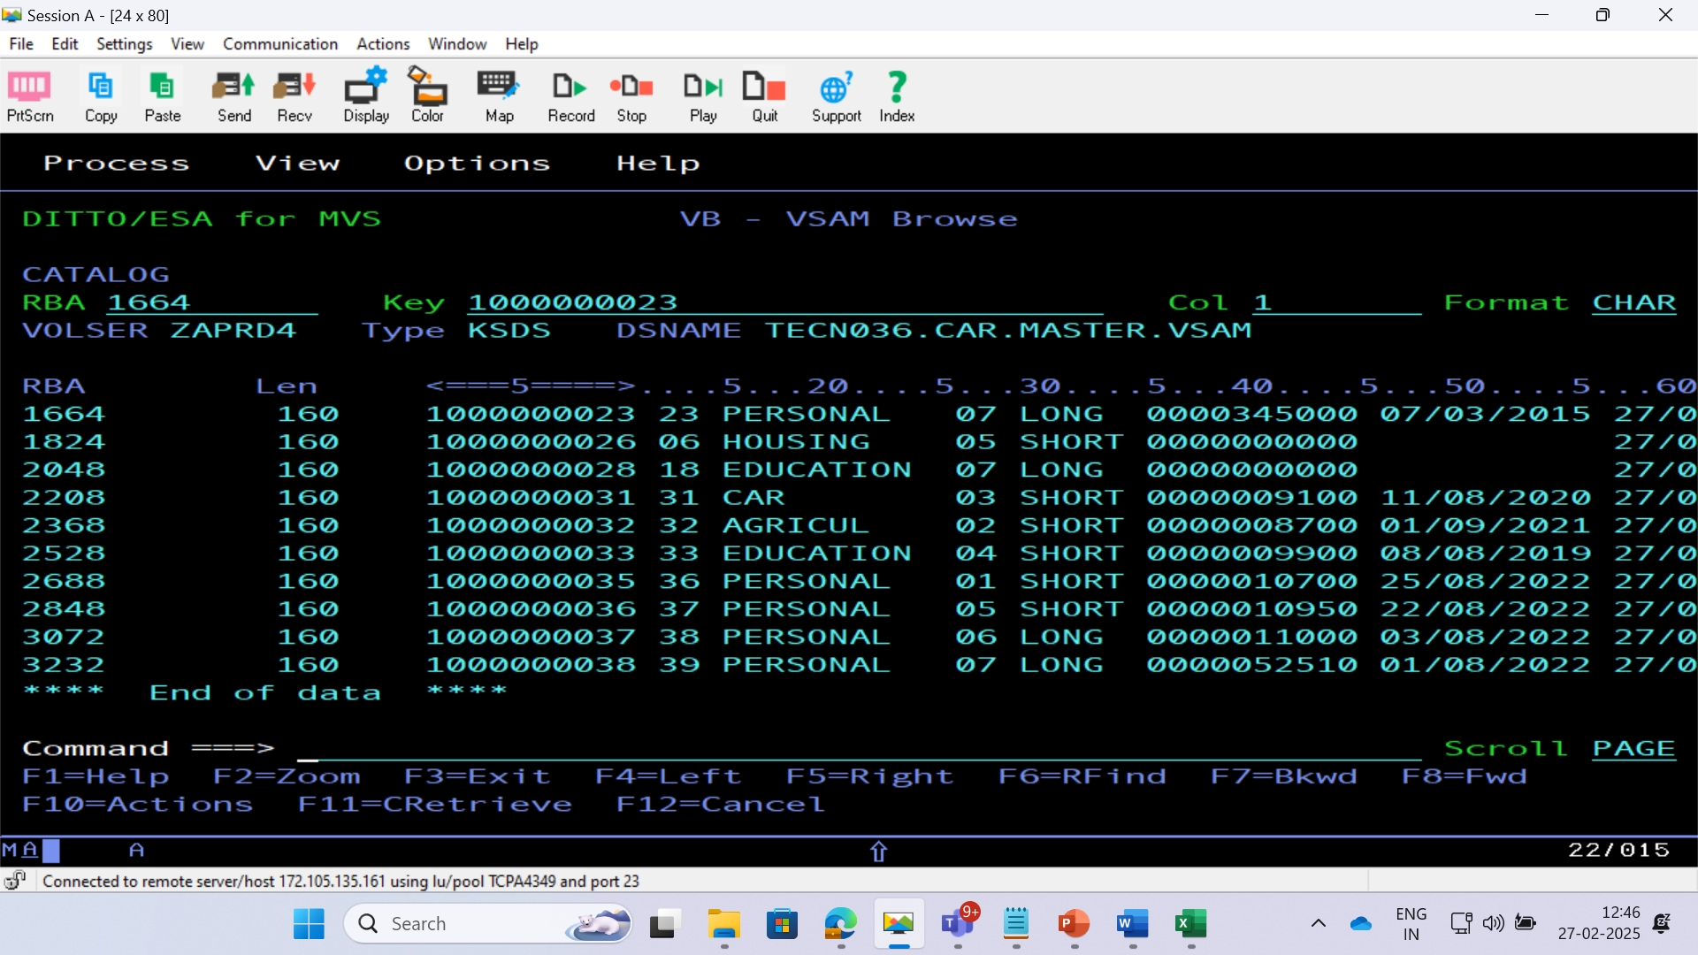

Slide 48
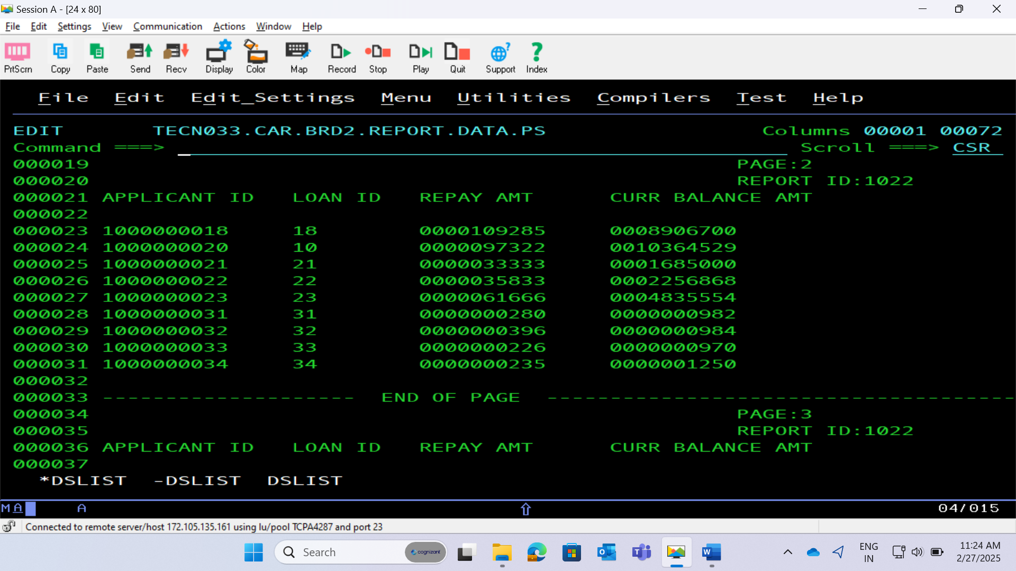
BRD 02 REPORT PS FILE

Slide 50
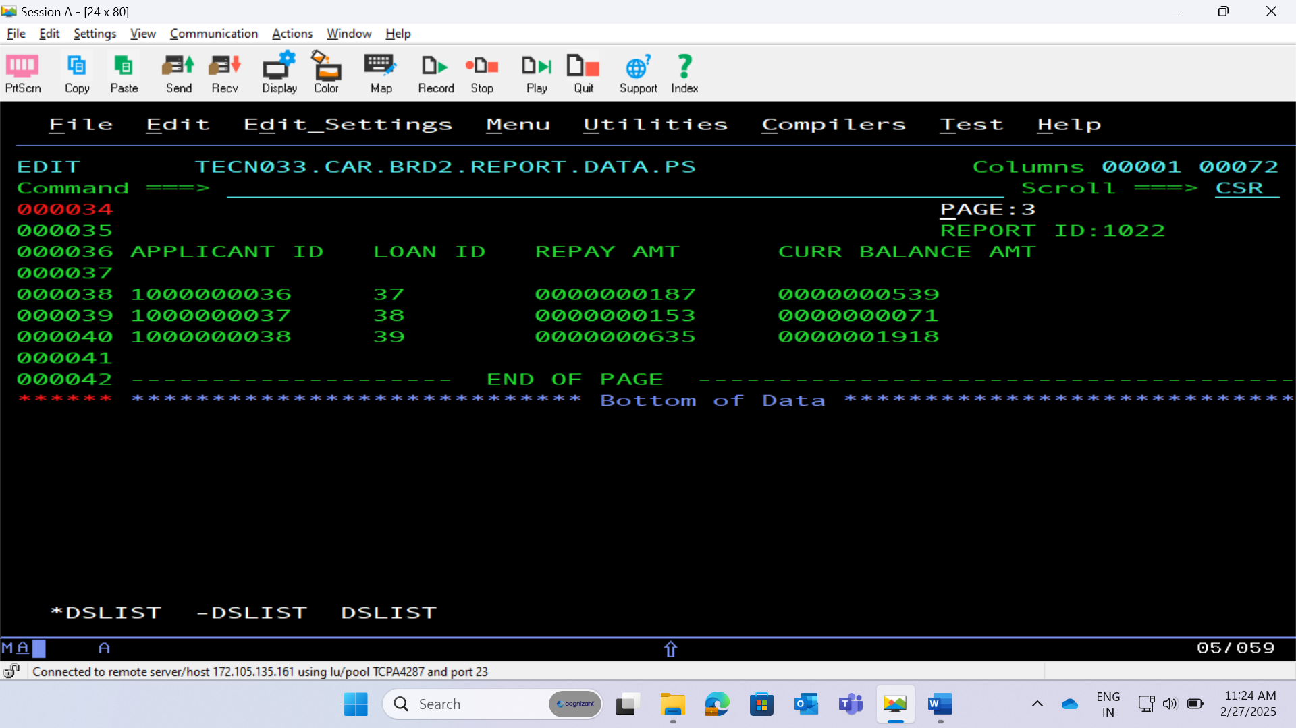

Slide 51
BRD : 03 - Daily Report of Missed Repayments
The process involves verifying if payments posted into the payment table cross the next repayment due date, calculating penalty fees for delayed payments, and generating a daily report in CSV format. It then involves sorting records by loan type, applicant ID, and loan ID, backing up the sorted report in a GDG file, and updating the Master Loan VSAM KSDS file with new payment details. Finally, it includes generating a report for applicants with monthly repayment amounts between 1000 and 2000 in the standard format with page breaks.

Slide 52
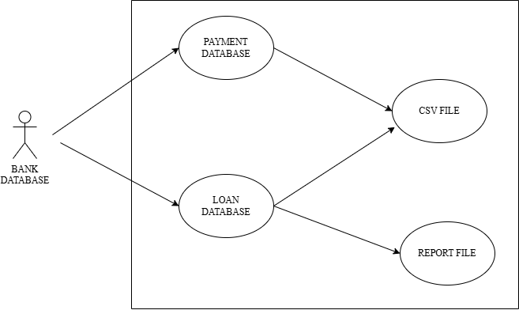
BRD : 03 – Use Case Diagram

Slide 53
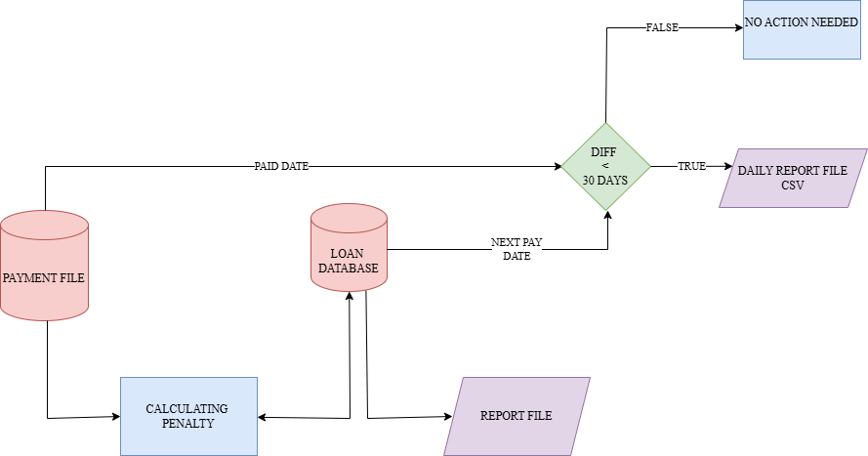
BRD : 03 – Flow Chart

Slide 54
PROCESS FLOW
Verifying Payment Dates
For each payment made, the payment date is compared to the next repayment due date. If the payment is late by less than 30 days, it is reported in a daily CSV report that includes detailed applicant and loan information.
2. Calculating Penalty Fees
Penalty fees for delayed payments are calculated based on the number of days late and the loan tenure type. Penalties vary and are applied as a percentage of the monthly repayment amount.
3. Sorting and Backing Up Records
Payment records are sorted by loan type, applicant ID, and loan ID using the SORT utility. The sorted report is then backed up in a GDG file with a limit of 12 versions, ensuring data integrity.

Slide 55
4. Updating Master Loan File
Newly added payment details are included in the Master Loan VSAM KSDS file. This keeps the master file updated with the latest payment information for all loans.
5. Generating Specific Reports
Applicants with monthly repayment amounts between 1000 and 2000 are identified, and separate report files are generated in the standard format with a maximum of 8 lines per page. This ensures comprehensive and organized reporting.

Slide 56
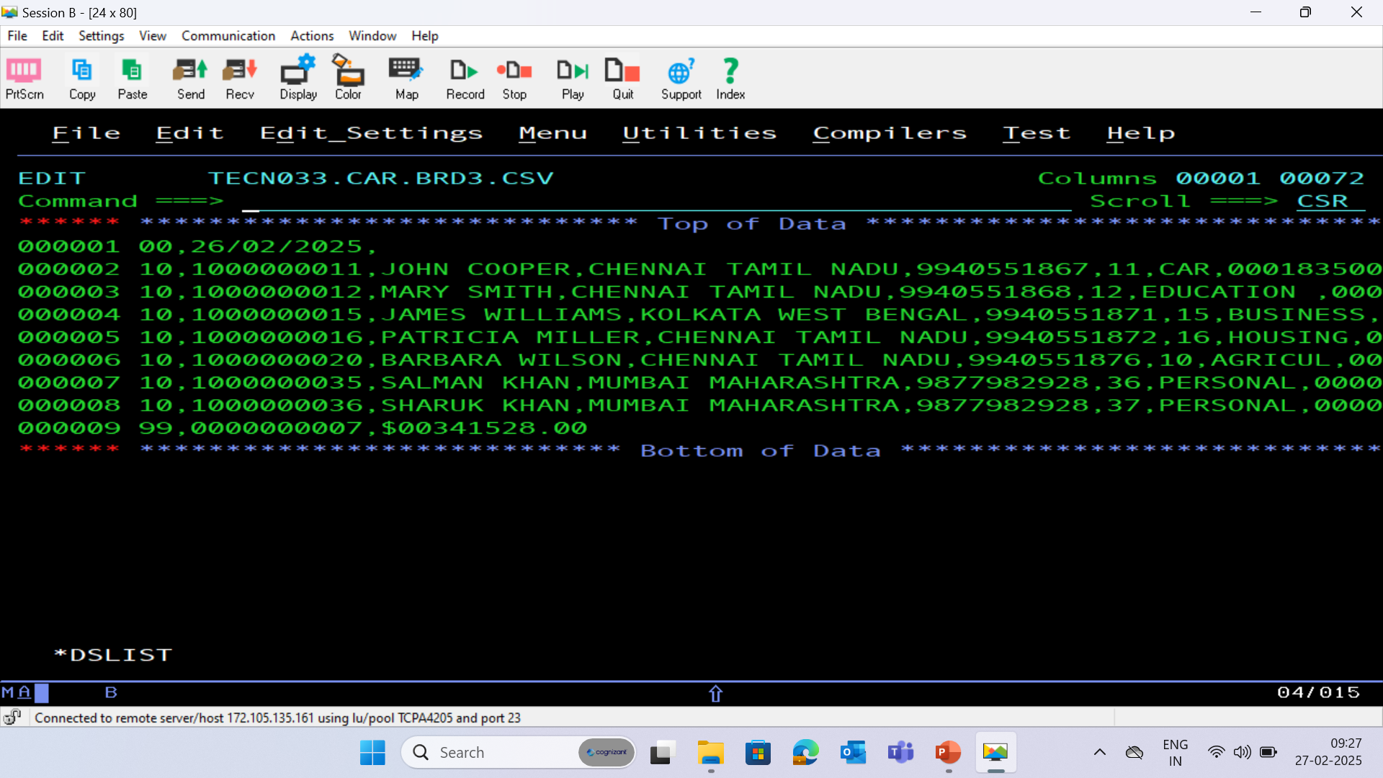
BRD 03 CSV (COMMA SEPERATED VALUES) FILE

Slide 57
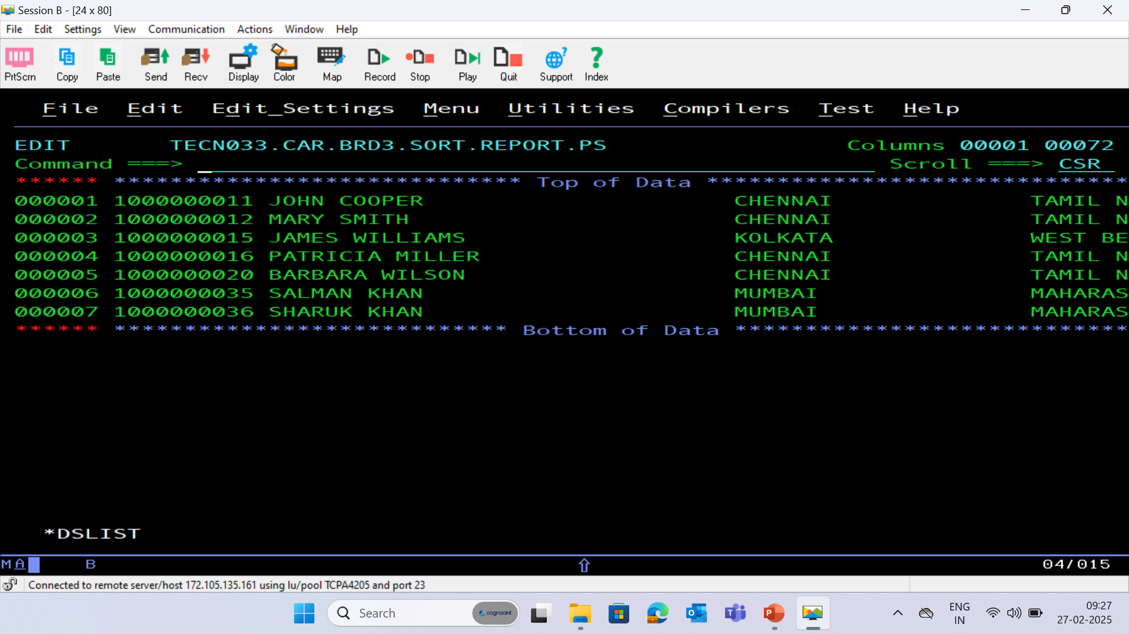
BRD 03 REPORT SORT FILE

Slide 58
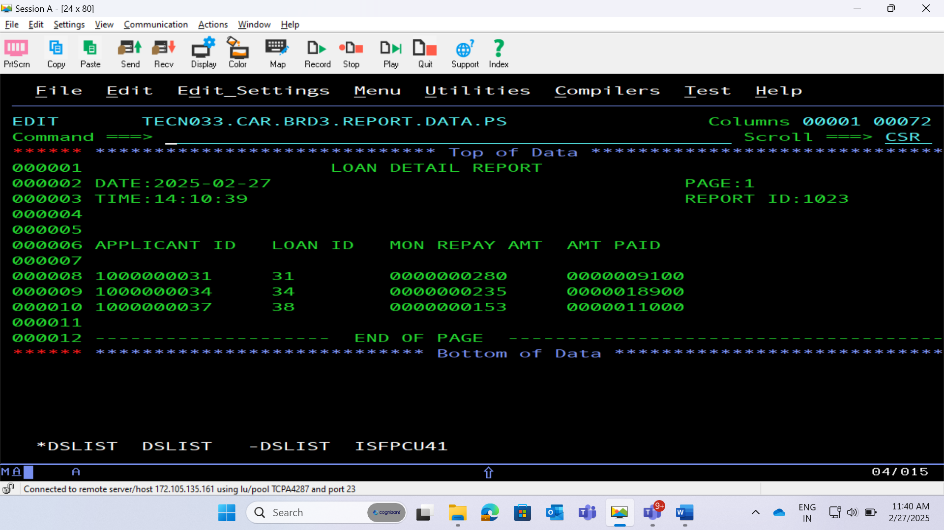
BRD 03 REPORT PS FILE

Slide 59
BRD : 04 - Weekly Report of Received Repayments
The process involves verifying if customer payments are made at least a week early compared to the next repayment due date and generating a weekly report in CSV format. It includes calculating discounts based on how early payments are made and updating the current balance amount accordingly. Records are sorted by loan type, applicant ID, loan ID, and due date, with a backup taken in a GDG file. Finally, details of applicants with current balances less than 30,000 are extracted and reported in the standard format with page breaks.

Slide 60
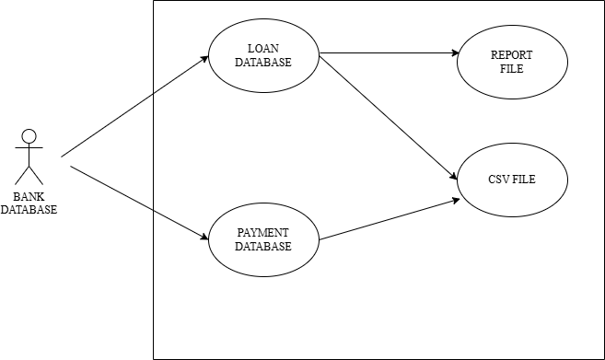
BRD : 04 – Use Case Diagram

Slide 61
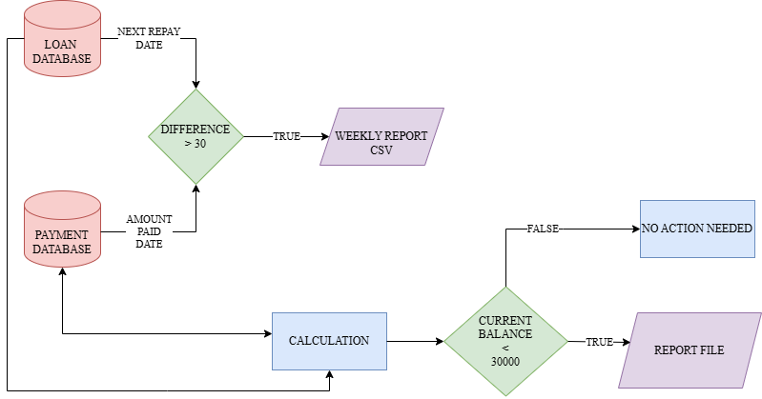
BRD : 04 – Flow Chart

Slide 62
PROCESS FLOW
Checking Early Payments
For each payment made, verify if it was done a week earlier than the next repayment due date, and report these details in a weekly CSV file to track early payments efficiently.
2. Calculating Discounts
Using subroutines, calculate the period between the current date and the repayment day for early payments, and apply discounts based on the number of days early. Update the payment database with the recalculated current balance amount.
3. Sorting and Backing Up Records
Sort the payment records by loan type, applicant ID, loan ID, and due date using the SORT utility, ensuring header and trailer records remain unchanged. Backup the sorted report in a GDG file with a limit of 10 versions for data security.

Slide 63
4. Performing Operations on Records
Perform operations on applicant records to calculate periods and apply discounts, recalculate current balances, and update the payment detail file and database. This ensures accurate financial records and rewards early payments.
5. Generating Reports
Extract details of applicants with a current balance amount less than 30,000, and generate separate report files in the standard format with a maximum of 8 lines per page, ensuring clear and organized reporting.

Slide 64
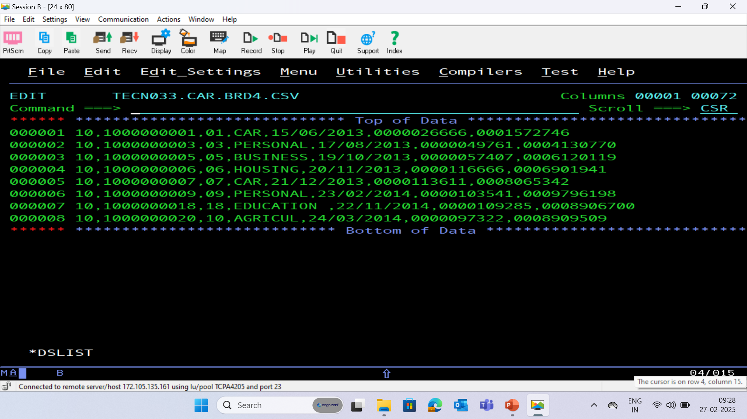
BRD 04 CSV (COMMA SEPERATED VALUES) FILE

Slide 65
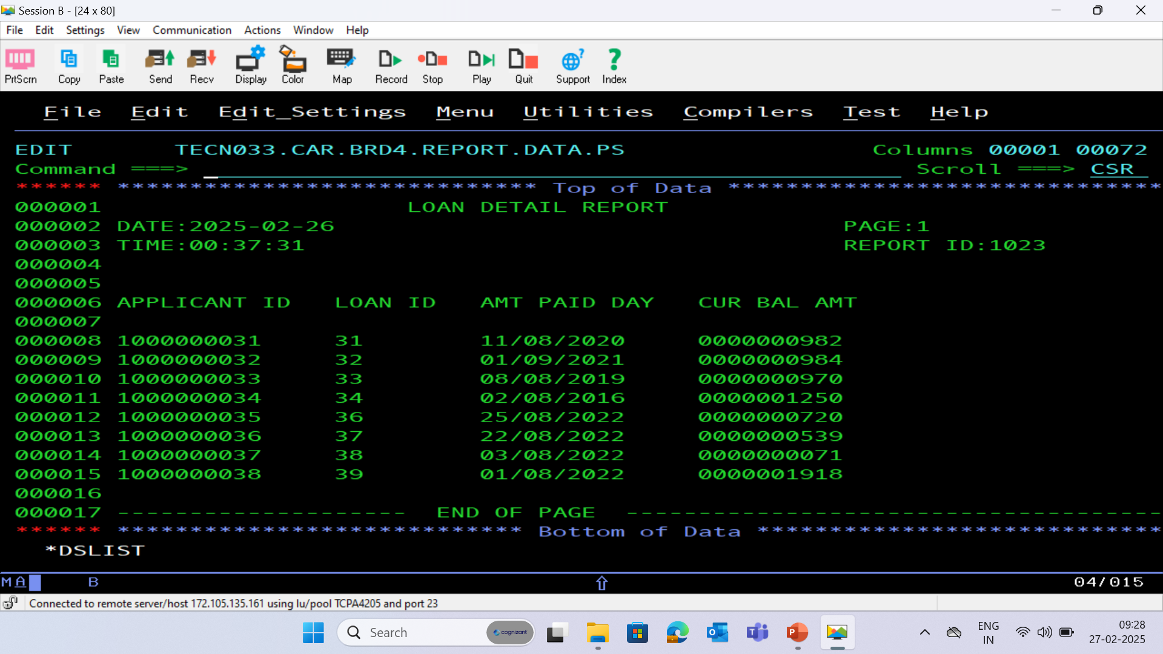
BRD 04 REPORT PS FILE

Slide 66
BRD : 05 - Data Cleanup and History Database Update
The process involves taking a backup of the Master Loan VSAM file, identifying and moving closed car loans to the history database, and deleting obsolete loan records from various databases. It includes sorting payment records, consolidating duplicate entries, and updating the loan closure dates for short-term car loans. Finally, it involves extracting details of applicants with specific loan tenure and closure dates, and generating reports in the standard format with page breaks.

Slide 67
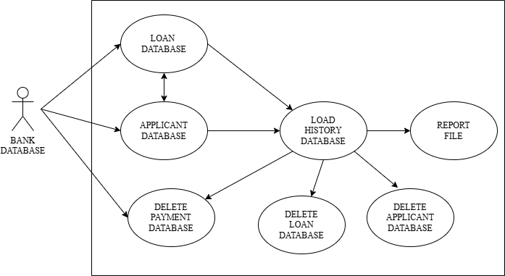
BRD : 05 – Use Case Diagram

Slide 68
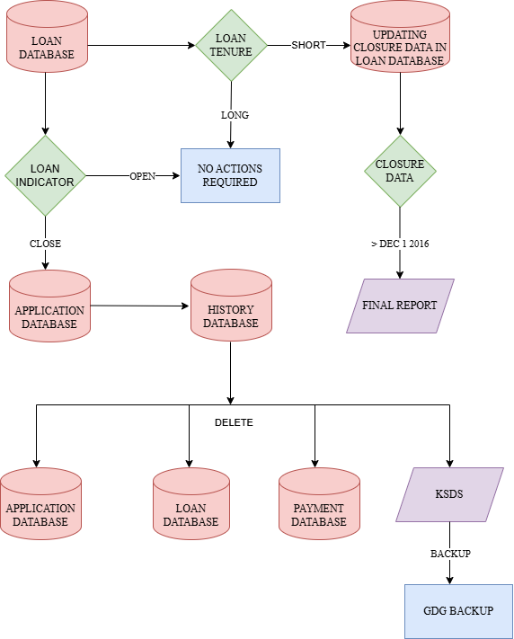
BRD : 05 – Flow Chart

Slide 69
PROCESS FLOW
Backing Up Data
The process begins by taking a backup of the Master Loan VSAM file in a Generation Data Group (GDG) file, ensuring data security and recoverability with a limit of 10 versions.
2. Identifying and Moving Closed Loans
Next, the loan database is swept to identify closed car loans, which are then moved to the history database. Corresponding entries in the applicant, loan, and payment databases, as well as the Master Loan VSAM file, are deleted.
3. Updating History Database
For closed loans, if all car loans of an applicant are obsolete, their details along with loan and payment records are deleted and moved to the history database. If only some loans are obsolete, only those specific records are moved.

Slide 70
4. Sorting Payment Records
After deletion, the payment file records are sorted in descending order based on Applicant ID. Duplicate records are consolidated by summing the amount paid, ensuring accurate and streamlined data.
5. Generating Reports
Details of applicants with short-term loan tenure and closure dates greater than Dec 1, 2016, are extracted. Reports are generated in the standard format with a maximum of 8 lines per page, ensuring organized and clear presentation of data.

Slide 71
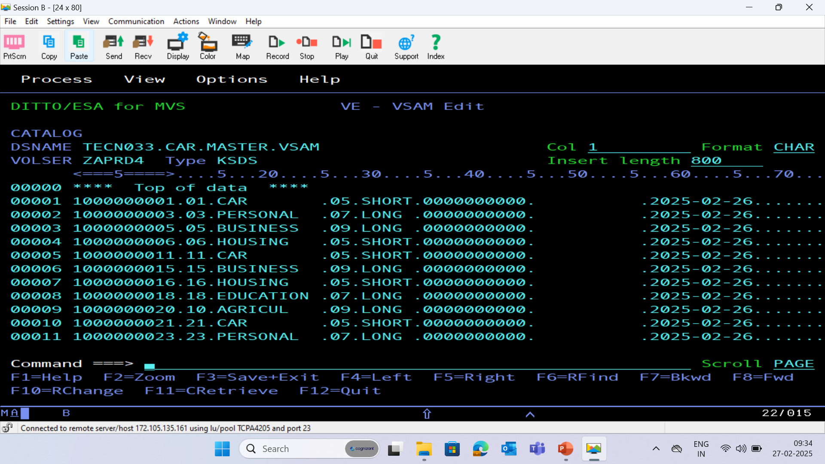
BRD 05 VSAM CLUSTER

Slide 72
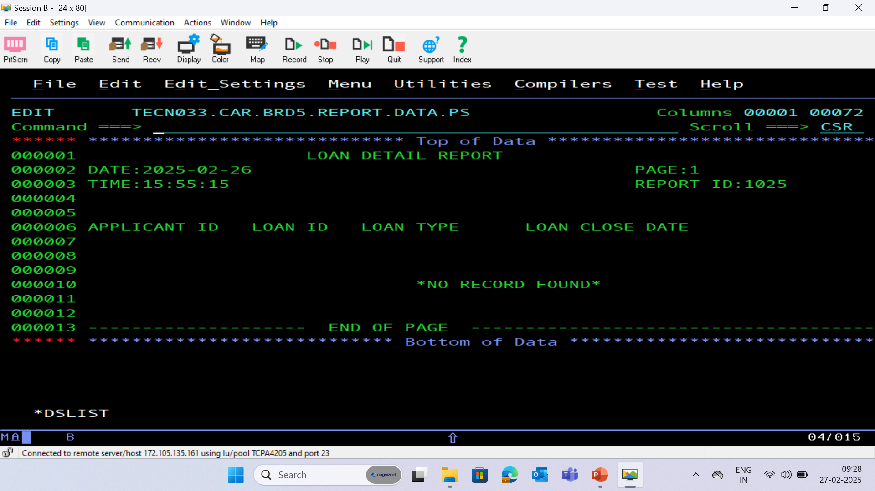
BRD 05 REPORT PS FILE

Slide 73
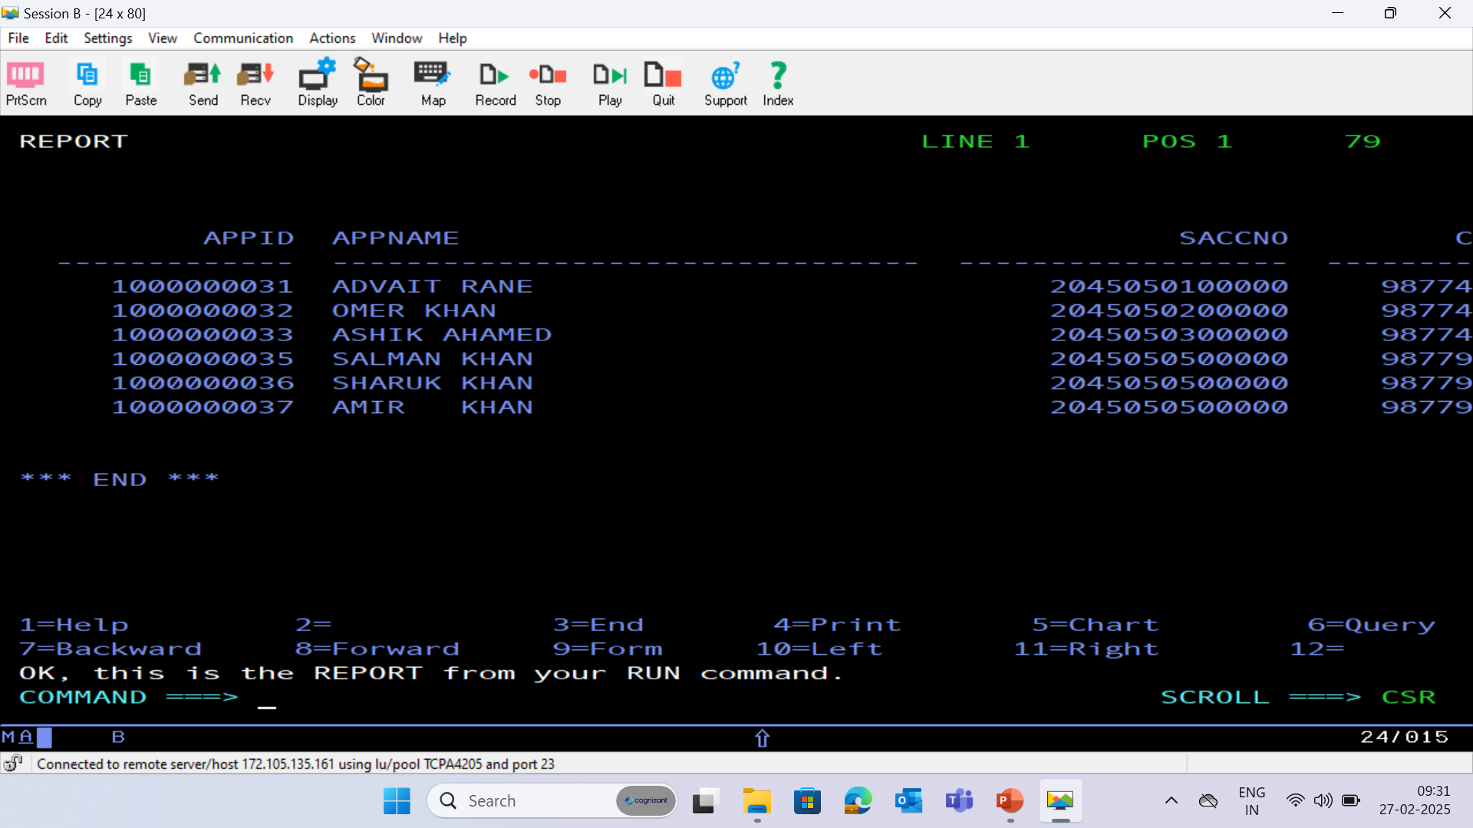
HISTORY DATABASE - (HISTORY)

Slide 74
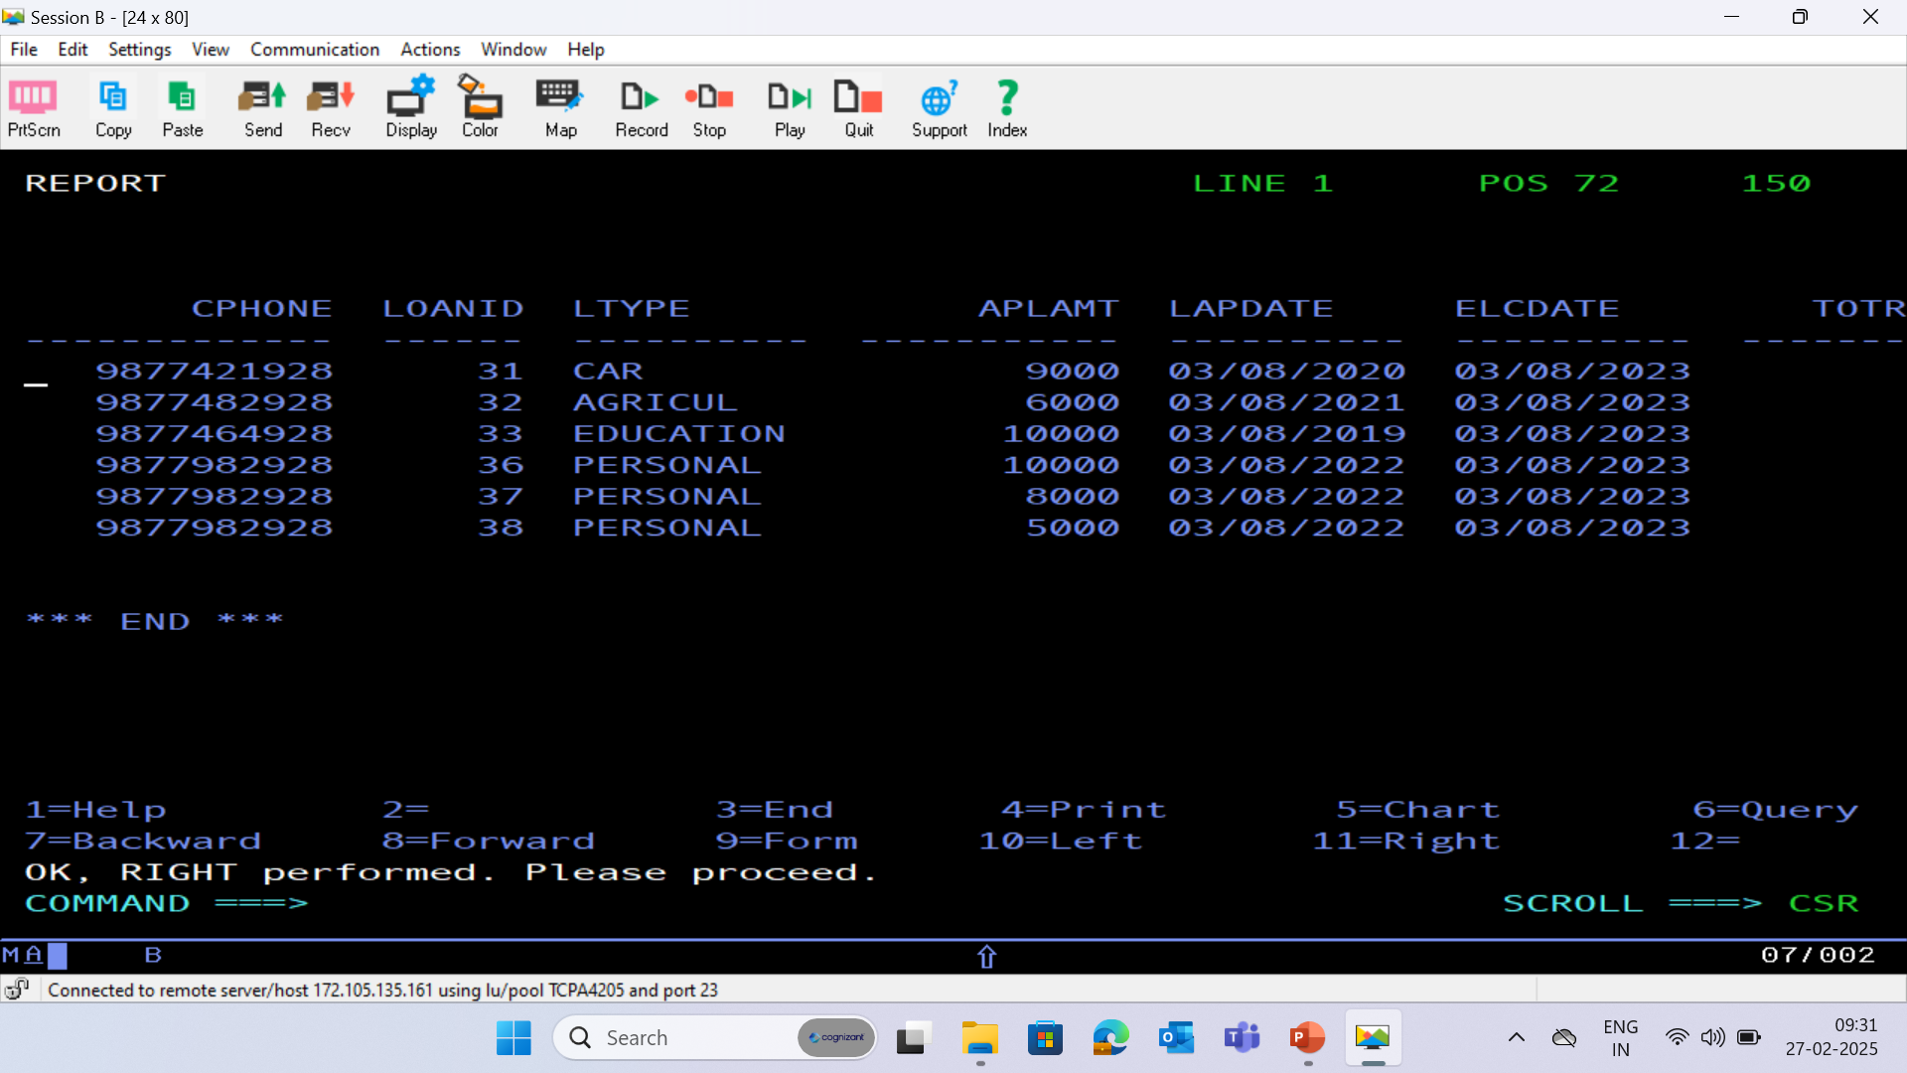

Slide 75
THANK YOU

